Slide 1

COURSE SLIDES · WSQ
QUANTUM
Securing the Future with Quantum Computing and Cryptography
WSQ Course Code: TGS-2024043419
Conducted by Tertiary Infotech Academy Pte Ltd · UEN 201200696W
Version 12.0 · 11 August 2026
© 2026 Tertiary Infotech Academy Pte Ltd. All rights reserved. · www.tertiarycourses.com.sg

Slide 2
COURSE ADMINISTRATION
Welcome & Housekeeping
Securing the Future with Quantum Computing and Cryptography · TGS-2024043419
© 2026 Tertiary Infotech Academy Pte Ltd
1

Slide 3
TRAQOM · SSG DIGITAL ATTENDANCE
Digital Attendance (Mandatory)
1
2
3
4
▶
▶
▶
Trainer displays the digital attendance QR code from the SSG portal
Scan the QR code with your mobile phone camera
Submit your attendance — AM, PM and Assessment, every day
75% minimum attendance is required for assessment and funding
Securing the Future with Quantum Computing and Cryptography · TGS-2024043419
© 2026 Tertiary Infotech Academy Pte Ltd
2

Slide 4
YOUR TRAINER · GENERAL
About the Trainer
NAME
____________________________________________
?
TITLE / DESIGNATION
____________________________________________
QUALIFICATIONS
____________________________________________
Your Trainer
AREAS OF EXPERTISE
____________________________________________
General Trainer template —
to be completed by the trainer
TRAINING & INDUSTRY EXPERIENCE
____________________________________________
CONTACT
____________________________________________
Securing the Future with Quantum Computing and Cryptography · TGS-2024043419
© 2026 Tertiary Infotech Academy Pte Ltd
3

Slide 5
YOUR TRAINER
About the Trainer
ROLE
Principal Trainer, Tertiary Infotech Academy Pte Ltd
AA
QUALIFICATIONS
PhD; ACTA / DACE certified adult educator.
EXPERTISE
Quantum computing, quantum cryptography, data science and AI engineering.
Dr Alfred Ang
DELIVERS
WSQ courses on quantum computing, cybersecurity and applied machine learning.
Principal Trainer
Tertiary Infotech Academy Pte Ltd
FOUNDER
Founder and lead instructor at Tertiary Infotech / Tertiary Courses.
Securing the Future with Quantum Computing and Cryptography · TGS-2024043419
© 2026 Tertiary Infotech Academy Pte Ltd
4

Slide 6
ICE-BREAKER
Let's Know Each Other
• Your name, organisation and role.
• Your background in physics, mathematics or programming (if any).
• What you want to be able to do with quantum computing after this course.
Securing the Future with Quantum Computing and Cryptography · TGS-2024043419
© 2026 Tertiary Infotech Academy Pte Ltd
5

Slide 7
HOUSEKEEPING
Ground Rules
Set your mobile phone to silent mode.
Participate actively — no question is too small.
1
2
Mutual respect: agree to disagree.
One conversation at a time.
3
4
Be punctual; return from breaks on time.
75% attendance is required for funding.
5
6
Securing the Future with Quantum Computing and Cryptography · TGS-2024043419
© 2026 Tertiary Infotech Academy Pte Ltd
6

Slide 8
COURSE PORTAL · LMS/TMS
Download Your Course Material
https://lms-tms.tertiaryinfotech.com
Go to lms-tms.tertiaryinfotech.com and sign in with the account you were issued.
1
My Courses
Securing the Future with Quantum Computing and Cryptography
Open My Courses and select this course.
2
Course Materials
Trainer Slides · Learner Guide · Lesson Plan
Download the Trainer Slides, Learner Guide and Lesson Plan.
Activities / Labs
Lab source code and QASM files
3
Assessment
Submit your WA and PP answers here
Keep them open — the assessment is OPEN BOOK.
4
Download the slides and Learner Guide BEFORE the assessment — they are your permitted open-book materials.
Securing the Future with Quantum Computing and Cryptography · TGS-2024043419
© 2026 Tertiary Infotech Academy Pte Ltd
7

Slide 9
WHAT YOU'LL ACHIEVE
Learning Outcomes
1
LO1 · Mathematical models
Design the mathematical models required for quantum computing applications.
2
LO2 · Physical methodologies
Decide on appropriate physical methodologies for quantum computing problems.
3
LO3 · Two-level models
Direct two-level quantum models for quantum computing.
4
LO4 · Business applicability
Evaluate quantum computing applicability in the business context.
5
LO5 · Quantum gates
Spearhead the application of quantum gates to quantum computing domains.
6
LO6 · Algorithm selection
Establish guidelines for selecting quantum computing algorithms.
7
LO7 · Synthesis
Synthesize quantum methodologies to address complex quantum computing problems.
Securing the Future with Quantum Computing and Cryptography · TGS-2024043419
© 2026 Tertiary Infotech Academy Pte Ltd
8

Slide 10
SCHEDULE
Lesson Plan — 4 Days, 8 hours/day
Days 1–2
Days 3–4
• Day 1 — Quantum Physics Fundamentals & Quantum Computing Systems
– Topic 1: Quantum Physics Fundamentals (Activity 1)
– Topic 2: Quantum Computing Systems (Activities 2–3)
• Day 2 — Quantum Gates, Circuits and Quantum Protocols
– Topic 3: Quantum Gates and Circuits (Activities 4–5)
– Topic 4: Quantum Protocols (Activities 6–8)
• Day 3 — Quantum Algorithms and Quantum Cryptography
– Topic 5: Quantum Algorithms (Activities 9–12)
– Topic 6: Quantum Cryptography & Safety (Activities 13–14)
• Day 4 — Applications, Error Correction and Assessment
– Topic 7: Applications (Activities 15–16)
– Topic 8: Quantum Error Correction (Activities 17–18)
– Final Assessment: WA (1 hr) + PP (1 hr)
Securing the Future with Quantum Computing and Cryptography · TGS-2024043419
© 2026 Tertiary Infotech Academy Pte Ltd
9

Slide 11
BEFORE YOU BEGIN
Briefing for Assessment
Phones away
Place phones and other materials under the table or on the floor.
No recording
No photos or recording of assessment scripts.
1
2
No discussion
Work individually — no discussion during the assessment.
Black or blue pen
Use a black/blue pen for hard-copy assessments.
3
4
No correction fluid
No liquid paper or correction tape on any script.
Time is called
Scripts are collected when the time is up.
5
6
Securing the Future with Quantum Computing and Cryptography · TGS-2024043419
© 2026 Tertiary Infotech Academy Pte Ltd
10

Slide 12
FINAL ASSESSMENT
Assessment
Written Assessment (WA)
Practical Performance (PP)
• Short-Answer Questions (SAQ)
• 1 hour · open book
• Tests underpinning KNOWLEDGE
• Covers all eight topics
• Hands-on quantum tasks
• 1 hour · open book
• Tests PRACTICAL ability
• Built on the class activities
OPEN BOOK — course slides, Learner Guide and approved materials only
Eligibility: minimum 75% attendance + assessed Competent. An appeal process is available.
Securing the Future with Quantum Computing and Cryptography · TGS-2024043419
© 2026 Tertiary Infotech Academy Pte Ltd
11

Slide 13
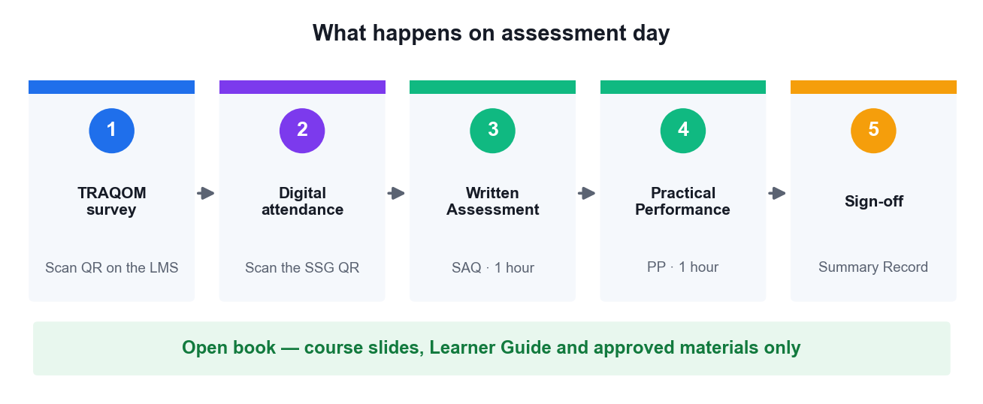
ON ASSESSMENT DAY
Assessment Flow
Complete every step in order — the TRAQOM survey and digital attendance are mandatory for funding.
Securing the Future with Quantum Computing and Cryptography · TGS-2024043419
© 2026 Tertiary Infotech Academy Pte Ltd
12

Slide 14
GETTING STARTED
Why Quantum, Why Now
Securing the Future with Quantum Computing and Cryptography · TGS-2024043419
© 2026 Tertiary Infotech Academy Pte Ltd
13

Slide 15
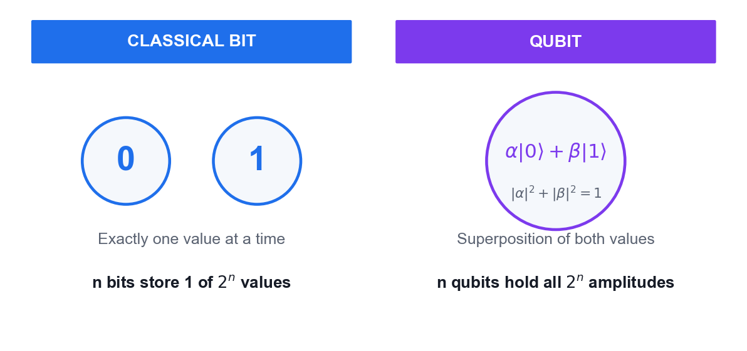
THE CORE IDEA
What Makes a Qubit Different
Classical bit
Holds exactly one value — 0 or 1 — at any instant.
Qubit
Holds a superposition of both, described by two complex amplitudes.
Measurement
Collapses the superposition to a single classical outcome.
The payoff
n qubits carry 2ⁿ amplitudes at once — quantum parallelism.
Securing the Future with Quantum Computing and Cryptography · TGS-2024043419
© 2026 Tertiary Infotech Academy Pte Ltd
14

Slide 16
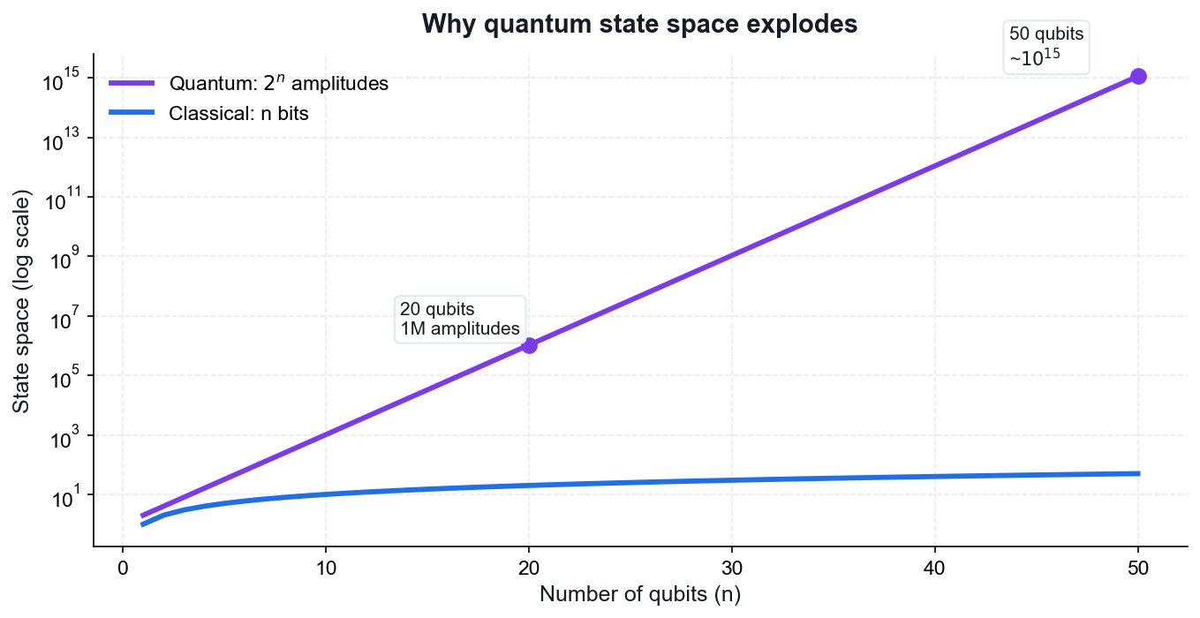
WHY IT MATTERS
The State Space Explosion
50 qubits
~10¹⁵ amplitudes — beyond any classical supercomputer's memory.
300 qubits
More amplitudes than atoms in the observable universe.
But
You only ever read out n classical bits — algorithms must be clever.
So
Interference, not brute force, is what gives quantum its advantage.
Securing the Future with Quantum Computing and Cryptography · TGS-2024043419
© 2026 Tertiary Infotech Academy Pte Ltd
15

Slide 17
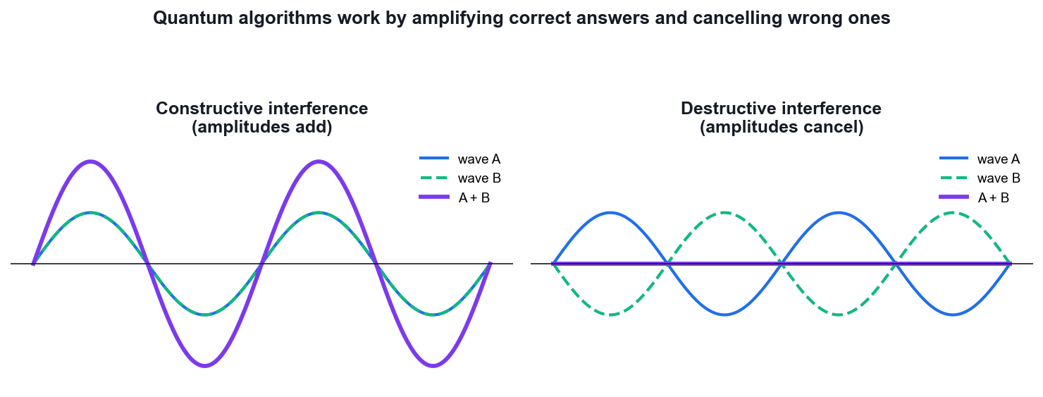
HOW QUANTUM ALGORITHMS WORK
Interference — The Real Engine
Amplitudes can cancel
Unlike probabilities, amplitudes are complex and can be negative.
Wrong answers cancel
A good algorithm arranges destructive interference on wrong paths.
Right answers add
Constructive interference concentrates probability on the answer.
Every algorithm
Deutsch, Grover and Shor are all interference engines.
Securing the Future with Quantum Computing and Cryptography · TGS-2024043419
© 2026 Tertiary Infotech Academy Pte Ltd
16

Slide 18
THE MENTAL MODEL
Superposition supplies the paths. Interference picks the answer.
Every quantum algorithm in this course follows that pattern — prepare a superposition, apply an oracle, then interfere so the correct answer survives.
Securing the Future with Quantum Computing and Cryptography · TGS-2024043419
© 2026 Tertiary Infotech Academy Pte Ltd
17

Slide 19
COURSE ED-TOOL · QUANTUMLAB BEGINNER
QuantumLab Beginner — Your Practice Environment
https://alfredang.github.io/quantumlabs/
Open alfredang.github.io/quantumlabs in any browser — no install.
1
Math Prerequisites & QM Postulates
Vectors, complex numbers, Hermitian, unitary, the 5 axioms
Pick the module matching the topic just taught.
2
Qubits · Bloch Sphere · Superposition
Interactive Bloch disc, probability slider, live Dirac panel
Use the interactive simulator to build intuition before the maths.
Entanglement · Bell's Inequality
Bell-pair simulator and a CHSH Monte-Carlo experiment
3
Circuits · Phase Kickback · Algorithms
Drag-and-drop builder, kickback explorer, Grover/DJ/QFT/Shor
Take the 3-question module quiz to check your understanding.
4
Built by Tertiary Infotech Academy — 18 interactive modules, runs entirely in the browser, no install.
Securing the Future with Quantum Computing and Cryptography · TGS-2024043419
© 2026 Tertiary Infotech Academy Pte Ltd
18

Slide 20
18 MODULES · alfredang.github.io/quantumlabs
What QuantumLab Covers
1
Reference modules
Math prerequisites, the five QM postulates, density matrices, history of QM.
2
Core concepts
Qubits, Bloch sphere, superposition, entanglement, measurement.
3
Bell's inequality
CHSH Monte-Carlo comparing the quantum 2√2 bound against local realism.
4
Circuit builder
Drag-and-drop 2ⁿ state-vector simulator with the full gate set.
5
Phase kickback
Four-state explorer showing the eigenvalue phase moving to the control.
6
Algorithms
Coin flip, Grover, Deutsch-Jozsa, teleportation, QFT and Shor with circuit diagrams.
7
Cryptography
BB84 key distribution with an optional Eve eavesdropper toggle.
8
Noise and QEC
Channel-noise propagation and a 3-qubit bit-flip Monte-Carlo.
Securing the Future with Quantum Computing and Cryptography · TGS-2024043419
© 2026 Tertiary Infotech Academy Pte Ltd
19

Slide 21
PREREQUISITES
The Mathematics of Quantum Mechanics
Linear algebra · Dirac notation · Unitary operators · The five axioms
Securing the Future with Quantum Computing and Cryptography · TGS-2024043419
© 2026 Tertiary Infotech Academy Pte Ltd
20

Slide 22
WHY THIS SECTION COMES FIRST
Quantum mechanics is linear algebra with a probability rule bolted on.
Everything in this course follows from five axioms and the properties of unitary and Hermitian operators. Get these right and every algorithm becomes readable.
Securing the Future with Quantum Computing and Cryptography · TGS-2024043419
© 2026 Tertiary Infotech Academy Pte Ltd
21

Slide 23
MATHEMATICAL PREREQUISITES
Vectors and Dirac notation
A quantum state is a COLUMN VECTOR. Dirac notation names it compactly.
KET |ψ> = column vector |0> = [1, 0]ᵀ , |1> = [0, 1]ᵀ
BRA <ψ| = conjugate transpose = (|ψ>)† = row vector
|ψ> = α|0> + β|1> = [α, β]ᵀ
<ψ| = α*<0| + β*<1| = [α*, β*]
KEY POINT: The bra is the DAGGER of the ket: transpose AND complex-conjugate.
Securing the Future with Quantum Computing and Cryptography · TGS-2024043419
© 2026 Tertiary Infotech Academy Pte Ltd
22

Slide 24
MATHEMATICAL PREREQUISITES
Inner product — overlap and probability
<φ|ψ> = a single COMPLEX NUMBER (a scalar)
<0|0> = 1 (normalised)
<0|1> = 0 (orthogonal)
<0|+> = 1/√2 (partial overlap)
Properties: <φ|ψ> = <ψ|φ>* and <ψ|ψ> = 1 for a valid state
KEY POINT: The inner product IS the probability amplitude — square its magnitude to get a probability (the Born rule).
Securing the Future with Quantum Computing and Cryptography · TGS-2024043419
© 2026 Tertiary Infotech Academy Pte Ltd
23

Slide 25
MATHEMATICAL PREREQUISITES
Outer product — operators and projectors
|ψ><φ| = a MATRIX (an operator), not a number
|0><0| = [[1,0],[0,0]] — projector onto |0>
|1><1| = [[0,0],[0,1]] — projector onto |1>
Completeness: |0><0| + |1><1| = I
Any operator: A = Σ_ij aᵢⱼ |i><j|
KEY POINT: Inner product = number. Outer product = matrix. Getting these two the right way round prevents most beginner errors.
Securing the Future with Quantum Computing and Cryptography · TGS-2024043419
© 2026 Tertiary Infotech Academy Pte Ltd
24

Slide 26
MATHEMATICAL PREREQUISITES
Tensor product — combining systems
|a> (x) |b> written |a>|b> or |ab>
|0> (x) |1> = [1,0]ᵀ (x) [0,1]ᵀ = [0, 1, 0, 0]ᵀ = |01>
Dimensions MULTIPLY: 2 (x) 2 = 4, and n qubits give 2ⁿ
Operators too: (A (x) B)(|a> (x) |b>) = A|a> (x) B|b>
KEY POINT: The tensor product is the mathematical source of exponential state space — and therefore of quantum advantage.
Securing the Future with Quantum Computing and Cryptography · TGS-2024043419
© 2026 Tertiary Infotech Academy Pte Ltd
25

Slide 27
MATHEMATICAL PREREQUISITES
Eigenvalues and eigenvectors
A|v> = λ|v> |v> is unchanged in DIRECTION, only scaled by λ
Find them by solving the characteristic equation det(A - λI) = 0.
Example — Pauli Z = [[1,0],[0,-1]]:
Z|0> = +1|0> eigenvalue +1, eigenvector |0>
Z|1> = -1|1> eigenvalue -1, eigenvector |1>
KEY POINT: Measurement outcomes ARE eigenvalues, and the measurement basis IS the eigenbasis. Eigenvectors of X are |+> and |->.
Securing the Future with Quantum Computing and Cryptography · TGS-2024043419
© 2026 Tertiary Infotech Academy Pte Ltd
26

Slide 28
THE CENTRAL PROPERTY
Definition
An operator U is UNITARY when:
U†U = UU† = I equivalently U⁻¹ = U†
where U† is the conjugate transpose (dagger / adjoint):
(U†)ᵢⱼ = (Uⱼᵢ)*
Example — Hadamard: H = (1/√2)[[1,1],[1,-1]]
H† = H (real and symmetric), and H·H = I so H is unitary.
KEY POINT: Checking U†U = I is the single most useful sanity test when you build a gate.
Securing the Future with Quantum Computing and Cryptography · TGS-2024043419
© 2026 Tertiary Infotech Academy Pte Ltd
27

Slide 29
THE CENTRAL PROPERTY
Property 1 — Unitary preserves the norm
<Uψ|Uψ> = <ψ|U†U|ψ> = <ψ|I|ψ> = <ψ|ψ> = 1
So a normalised state STAYS normalised.
Consequence: probabilities always sum to 1, at every step of the circuit.
A non-unitary gate would create or destroy probability — unphysical.
KEY POINT: This is why you never need to renormalise mid-circuit; only measurement (which is not unitary) requires it.
Securing the Future with Quantum Computing and Cryptography · TGS-2024043419
© 2026 Tertiary Infotech Academy Pte Ltd
28

Slide 30
THE CENTRAL PROPERTY
Property 2 — Unitary preserves inner products
<Uφ|Uψ> = <φ|U†U|ψ> = <φ|ψ>
ANGLES between states are preserved. Orthogonal states stay orthogonal.
Geometric picture: a unitary is a ROTATION (possibly with reflection) of
the state space — it is rigid, it never stretches or squashes.
KEY POINT: This single property is what makes the no-cloning proof work.
Securing the Future with Quantum Computing and Cryptography · TGS-2024043419
© 2026 Tertiary Infotech Academy Pte Ltd
29

Slide 31
THE CENTRAL PROPERTY
Property 3 — Unitary is reversible
U⁻¹ = U† always EXISTS.
So every quantum gate can be undone: U†(U|ψ>) = |ψ>
Consequences:
• quantum circuits have equal input and output wire counts
• no information is ever erased (no Landauer heat cost)
• classical AND/OR are NOT valid gates — they lose a bit
• classical logic must be made reversible first (Toffoli gate)
KEY POINT: Reversibility is a constraint on circuit design, not a convenience — you cannot 'discard' a qubit mid-computation without consequences.
Securing the Future with Quantum Computing and Cryptography · TGS-2024043419
© 2026 Tertiary Infotech Academy Pte Ltd
30

Slide 32
THE CENTRAL PROPERTY
Property 4 — Eigenvalues lie on the unit circle
If U|v> = λ|v>, then norm preservation forces:
|λ| = 1 so λ = e^(iθ) for some real θ
Unitary operators can only apply PHASES to their eigenvectors —
never amplify or damp them.
This fact is the entire basis of QUANTUM PHASE ESTIMATION.
KEY POINT: Phase estimation exists precisely because unitary eigenvalues are pure phases: estimating λ reduces to estimating the single real number θ.
Securing the Future with Quantum Computing and Cryptography · TGS-2024043419
© 2026 Tertiary Infotech Academy Pte Ltd
31

Slide 33
THE CENTRAL PROPERTY
Unitary vs Hermitian — do not confuse them
UNITARY U†U = I describes EVOLUTION (gates)
eigenvalues on the unit circle, e^(iθ)
HERMITIAN A† = A describes OBSERVABLES (measurements)
eigenvalues REAL
The Pauli gates X, Y, Z are BOTH — which is why they serve as gates
and as measurement observables. H is also both.
Link: A Hermitian => U = e^(iA) is unitary.
KEY POINT: A common exam question. Unitary = evolution; Hermitian = observable; the Paulis happen to be both.
Securing the Future with Quantum Computing and Cryptography · TGS-2024043419
© 2026 Tertiary Infotech Academy Pte Ltd
32

Slide 34
BEYOND PURE STATES
Why state vectors are not enough
A ket |ψ> describes a PURE state — full knowledge of the system.
But real systems are often:
• statistical mixtures (the source emits |0> or |1> at random)
• entangled with an environment we cannot access
• one half of an entangled pair
None of these can be written as a single ket.
KEY POINT: You need the density matrix as soon as you discuss noise, decoherence or subsystems — which is to say, any real device.
Securing the Future with Quantum Computing and Cryptography · TGS-2024043419
© 2026 Tertiary Infotech Academy Pte Ltd
33

Slide 35
BEYOND PURE STATES
Definition
PURE state: ρ = |ψ><ψ|
MIXED state: ρ = Σ_i pᵢ |ψᵢ><ψᵢ| with Σ pᵢ = 1
Properties of any valid density matrix:
ρ† = ρ (Hermitian)
Tr(ρ) = 1 (probabilities sum to 1)
ρ ≥ 0 (positive semi-definite)
KEY POINT: The density matrix generalises the state vector — every ket has a ρ, but not every ρ has a ket.
Securing the Future with Quantum Computing and Cryptography · TGS-2024043419
© 2026 Tertiary Infotech Academy Pte Ltd
34

Slide 36
BEYOND PURE STATES
Distinguishing pure from mixed
Tr(ρ²) = 1 <=> PURE
Tr(ρ²) < 1 <=> MIXED
The maximally mixed single-qubit state:
ρ = I/2 = [[0.5, 0],[0, 0.5]] Tr(ρ²) = 0.5
This carries NO information — every measurement gives 50/50 in every basis.
KEY POINT: Bob's qubit before he receives the classical bits in teleportation is exactly I/2 — which is why no faster-than-light signalling occurs.
Securing the Future with Quantum Computing and Cryptography · TGS-2024043419
© 2026 Tertiary Infotech Academy Pte Ltd
35

Slide 37
BEYOND PURE STATES
Superposition vs mixture
SUPERPOSITION |+> = (|0>+|1>)/√2
ρ = [[0.5, 0.5],[0.5, 0.5]] OFF-DIAGONALS PRESENT
Measure in X basis: always |+> — deterministic!
MIXTURE '50% |0>, 50% |1>'
ρ = [[0.5, 0],[0, 0.5]] OFF-DIAGONALS ZERO
Measure in X basis: 50/50 — random
In the Z basis BOTH give 50/50 — they look identical.
KEY POINT: The off-diagonal terms are the COHERENCES. Decoherence is precisely the process that decays them, turning a superposition into a mixture.
Securing the Future with Quantum Computing and Cryptography · TGS-2024043419
© 2026 Tertiary Infotech Academy Pte Ltd
36

Slide 38
THE AXIOMS OF QUANTUM MECHANICS
The Five Postulates — Overview
• Postulate 1 — STATE SPACE: a state is a unit vector in a complex Hilbert space.
• Postulate 2 — TIME EVOLUTION: closed systems evolve by a unitary operator.
• Postulate 3 — OBSERVABLES: measurable quantities are Hermitian operators.
• Postulate 4 — BORN RULE: probability is the squared magnitude of the amplitude.
• Postulate 5 — COLLAPSE: measurement projects the state onto the observed eigenspace.
Securing the Future with Quantum Computing and Cryptography · TGS-2024043419
© 2026 Tertiary Infotech Academy Pte Ltd
37

Slide 39
THE FIVE AXIOMS OF QUANTUM MECHANICS
Postulate 1 — State Space
The state of an isolated quantum system is a UNIT VECTOR in a complex Hilbert space H.
WHAT IT MEANS
|ψ> ∈ H, with <ψ|ψ> = 1
A single qubit: H = C², spanned by |0> and |1>
|ψ> = α|0> + β|1>, α, β ∈ C, |α|² + |β|² = 1
n qubits: H = C² (x) C² (x) … (x) C² = C^(2ⁿ)
The amplitudes α and β are COMPLEX numbers, not probabilities.
Normalisation <ψ|ψ> = 1 says the total probability is 1.
A GLOBAL phase carries no physics: |ψ> and e^(iφ)|ψ> are the same state.
A RELATIVE phase between terms is physical — it drives interference.
WHY IT MATTERS: This is why n qubits hold 2ⁿ amplitudes: the state space is a TENSOR PRODUCT, so dimensions multiply rather than add. 300 qubits carry more amplitudes than there are atoms in the observable universe.
Securing the Future with Quantum Computing and Cryptography · TGS-2024043419
© 2026 Tertiary Infotech Academy Pte Ltd
38

Slide 40
THE FIVE AXIOMS OF QUANTUM MECHANICS
Postulate 2 — Time Evolution (Unitarity)
A closed quantum system evolves by a UNITARY operator.
WHAT IT MEANS
|ψ(t)> = U |ψ(0)>, where U†U = UU† = I
Equivalently, from the Schrödinger equation:
iħ d|ψ>/dt = H|ψ> => U = e^(-iHt/ħ)
with H the Hamiltonian (Hermitian, so U is unitary).
EVERY quantum gate is unitary — this is not a design choice but a law.
Unitary => REVERSIBLE: U⁻¹ = U† always exists, so no information is destroyed.
Unitary => NORM-PRESERVING: probabilities still sum to 1 after the operation.
There is no quantum AND or OR gate — those are irreversible and lose information.
WHY IT MATTERS: Reversibility is why quantum circuits have the same number of output wires as input wires, and why classical logic must be embedded reversibly (Toffoli) before a quantum computer can run it.
Securing the Future with Quantum Computing and Cryptography · TGS-2024043419
© 2026 Tertiary Infotech Academy Pte Ltd
39

Slide 41
THE FIVE AXIOMS OF QUANTUM MECHANICS
Postulate 3 — Observables
Every measurable physical quantity is represented by a HERMITIAN operator.
WHAT IT MEANS
A observable <=> A† = A
Spectral decomposition: A = Σ_i λᵢ |i><i|
λᵢ — real eigenvalues = the possible measurement OUTCOMES
|i> — orthonormal eigenvectors = the measurement BASIS
Example: Z = |0><0| - |1><1|, eigenvalues +1 and -1
Hermitian guarantees REAL eigenvalues — measurement results are real numbers.
Eigenvectors of a Hermitian operator are orthogonal and form a complete basis.
Measuring 'in the Z basis' means measuring the observable Z.
Non-commuting observables (like X and Z) cannot be measured simultaneously.
WHY IT MATTERS: The uncertainty principle follows directly: if [A,B] ≠ 0 the two observables have no common eigenbasis, so no state has definite values for both. That is why BB84's two bases are conjugate and why eavesdropping is detectable.
Securing the Future with Quantum Computing and Cryptography · TGS-2024043419
© 2026 Tertiary Infotech Academy Pte Ltd
40

Slide 42
THE FIVE AXIOMS OF QUANTUM MECHANICS
Postulate 4 — The Born Rule
The probability of an outcome is the SQUARED MAGNITUDE of its amplitude.
WHAT IT MEANS
P(outcome i) = |<i|ψ>|² = <ψ|Pᵢ|ψ> with Pᵢ = |i><i|
For |ψ> = α|0> + β|1>:
P(0) = |α|², P(1) = |β|², |α|² + |β|² = 1
Expectation value of an observable A:
<A> = <ψ|A|ψ> = Σ_i λᵢ P(i)
Amplitudes ADD (and can cancel); probabilities never cancel.
This squaring is what makes interference possible — the source of quantum advantage.
The rule is fundamentally PROBABILISTIC: identical states can give different results.
To estimate a probability you must repeat the circuit many times ('shots').
WHY IT MATTERS: The Born rule is why quantum algorithms must ENGINEER interference: you cannot read amplitudes directly, so you must arrange for wrong answers to cancel and the right answer to be amplified before measuring.
Securing the Future with Quantum Computing and Cryptography · TGS-2024043419
© 2026 Tertiary Infotech Academy Pte Ltd
41

Slide 43
THE FIVE AXIOMS OF QUANTUM MECHANICS
Postulate 5 — Measurement Collapse
Measurement PROJECTS the state onto the observed eigenspace and renormalises.
WHAT IT MEANS
If outcome i is observed, the post-measurement state is:
|ψ'> = Pᵢ|ψ> / √(<ψ|Pᵢ|ψ>)
Example: |ψ> = (|0> + |1>)/√2 , measure Z and get 0
|ψ'> = |0> — the superposition is GONE
Measuring again immediately returns 0 with probability 1.
Measurement is IRREVERSIBLE — the only non-unitary operation in quantum mechanics.
Information about the other branches is destroyed permanently.
You cannot 'peek' at a quantum state without disturbing it.
This is why you measure ONCE, at the very end of a quantum circuit.
WHY IT MATTERS: Collapse is the security mechanism of QKD (Eve's measurement disturbs the state) AND the central obstacle in error correction (you must diagnose an error WITHOUT measuring the data — hence syndrome measurement on ancillas).
Securing the Future with Quantum Computing and Cryptography · TGS-2024043419
© 2026 Tertiary Infotech Academy Pte Ltd
42

Slide 44
KEEP THIS FOR THE OPEN-BOOK ASSESSMENT
The Five Postulates — Reference Card
#
Postulate
Mathematics
Governs
1
State space
|ψ> ∈ H, <ψ|ψ> = 1
What a state IS
2
Time evolution
|ψ'> = U|ψ>, U†U = I
How states CHANGE
3
Observables
A† = A, real eigenvalues
What can be MEASURED
4
Born rule
P(i) = |<i|ψ>|²
How LIKELY each outcome is
5
Collapse
|ψ'> = Pᵢ|ψ> / √<ψ|Pᵢ|ψ>
What happens AFTER measuring
Securing the Future with Quantum Computing and Cryptography · TGS-2024043419
© 2026 Tertiary Infotech Academy Pte Ltd
43

Slide 45
01
TOPIC 01
Quantum Physics Fundamentals
Postulates of Quantum Mechanics · Mathematics for Quantum Mechanics
Securing the Future with Quantum Computing and Cryptography · TGS-2024043419
© 2026 Tertiary Infotech Academy Pte Ltd
44

Slide 46
MAPS TO LO1
Key Concepts — Quantum Physics Fundamentals
The five postulates
State space, unitary time evolution, observables, the Born rule and wave-function collapse are the axioms every quantum algorithm obeys.
Hilbert space
Quantum states are unit vectors in a complex inner-product space; a single qubit lives in a 2-dimensional Hilbert space.
1
2
Unitary operators
U†U = I preserves the norm — this is why every quantum gate is reversible and probability is conserved.
Hermitian operators
A† = A guarantees real eigenvalues, so Hermitian operators represent physically measurable observables.
3
4
Dirac notation
Bra-ket notation compactly expresses states |ψ⟩, dual vectors ⟨ψ|, inner products ⟨φ|ψ⟩ and outer products |ψ⟩⟨φ|.
Tensor products
The state space of a multi-qubit system is the tensor product of the single-qubit spaces — dimension grows as 2ⁿ.
5
6
Securing the Future with Quantum Computing and Cryptography · TGS-2024043419
© 2026 Tertiary Infotech Academy Pte Ltd
45

Slide 47
THE THREE OBJECTS YOU NEED
The Mathematical Toolkit
State vector
Unitary operator
Hermitian operator
|ψ⟩ = α|0⟩ + β|1⟩
U†U = I
A† = A
A qubit is a unit vector in a 2-dimensional Hilbert space, with |α|² + |β|² = 1.
Every quantum gate is unitary — reversible, and probability-preserving.
Observables are Hermitian, which guarantees real measured eigenvalues.
Securing the Future with Quantum Computing and Cryptography · TGS-2024043419
© 2026 Tertiary Infotech Academy Pte Ltd
46

Slide 48
BRA-KET NOTATION
Dirac Notation at a Glance
Ket / Bra
Inner product
Born rule
|ψ⟩ and ⟨ψ|
⟨φ|ψ⟩
P(x) = |⟨x|ψ⟩|²
A ket is a column vector; a bra is its conjugate transpose (row vector).
A single complex number — the overlap, or probability amplitude, between two states.
The probability of measuring outcome x is the squared magnitude of the amplitude.
Securing the Future with Quantum Computing and Cryptography · TGS-2024043419
© 2026 Tertiary Infotech Academy Pte Ltd
47

Slide 49
WHAT YOU'LL DO
Hands-On Activities — Quantum Physics Fundamentals
Activity 1
• Linear Algebra for Quantum Mechanics in Python
Securing the Future with Quantum Computing and Cryptography · TGS-2024043419
© 2026 Tertiary Infotech Academy Pte Ltd
48

Slide 50
TOPIC 01 · HANDS-ON ACTIVITY
ACTIVITY 1
Linear Algebra for Quantum Mechanics in Python
Work with the mathematical objects every quantum algorithm is built from: state vectors, inner and outer products, unitary and Hermitian operators, eigenvalues and tensor products — all in NumPy.
MAPS TO LO1 — Design mathematical models required for quantum computing applications
YOU'LL PRODUCE
A Python notebook that verifies unitarity and Hermiticity, computes eigenvalues/eigenvectors, and builds two-qubit states with the tensor product.
Tools: Python 3.13, NumPy, Google Colab / VS Code
Full step-by-step guide: Learner Guide — Activity 1: Linear Algebra for Quantum Mechanics in Python
Securing the Future with Quantum Computing and Cryptography · TGS-2024043419
© 2026 Tertiary Infotech Academy Pte Ltd
49

Slide 51
ACTIVITY 1 · VERIFY & DEBRIEF
Linear Algebra for Quantum Mechanics in Python
TEST IT — HOW YOU KNOW IT WORKED
H-dagger H equals the identity, X and Z return real eigenvalues +1 and -1, the Born-rule probability of measuring 0 in |+> is 0.5, and the tensor product produces a 4-component two-qubit state.
DISCUSS WITH YOUR TRAINER
What did the result show?
Why does it work?
Where would you use it?
Restate the outcome in your own words.
Name the quantum principle the activity relies on.
Give one realistic application in your own field.
Securing the Future with Quantum Computing and Cryptography · TGS-2024043419
© 2026 Tertiary Infotech Academy Pte Ltd
50

Slide 52
TOPIC RECAP
Recap — Quantum Physics Fundamentals
• The five postulates
• Hilbert space
• Unitary operators
• Hermitian operators
• Dirac notation
• Tensor products
Securing the Future with Quantum Computing and Cryptography · TGS-2024043419
© 2026 Tertiary Infotech Academy Pte Ltd
51

Slide 53
02
TOPIC 02
Introduction to Quantum Computing Systems
Overview of quantum computers · Commercial systems · Superposition and Entanglement
Securing the Future with Quantum Computing and Cryptography · TGS-2024043419
© 2026 Tertiary Infotech Academy Pte Ltd
52

Slide 54
MAPS TO LO2, LO4
Key Concepts — Introduction to Quantum Computing Systems
Qubit vs classical bit
A bit is 0 or 1; a qubit is α|0⟩ + β|1⟩ with |α|² + |β|² = 1, allowing superposition of both values.
Bloch sphere
Every pure single-qubit state maps to a point on the unit sphere — the standard geometric picture of qubit state and rotation.
1
2
Physical qubits
Superconducting (Josephson junction), trapped-ion and topological qubits trade off speed, coherence time and connectivity.
Commercial platforms
IBM Quantum, Google, IonQ, Rigetti and D-Wave offer cloud access to real quantum processors today.
3
4
Superposition
A quantum register of n qubits holds a superposition of all 2ⁿ basis states simultaneously — the source of quantum parallelism.
Entanglement
Entangled states cannot be written as a product of single-qubit states; measuring one qubit instantly correlates with the other.
5
6
Securing the Future with Quantum Computing and Cryptography · TGS-2024043419
© 2026 Tertiary Infotech Academy Pte Ltd
53

Slide 55
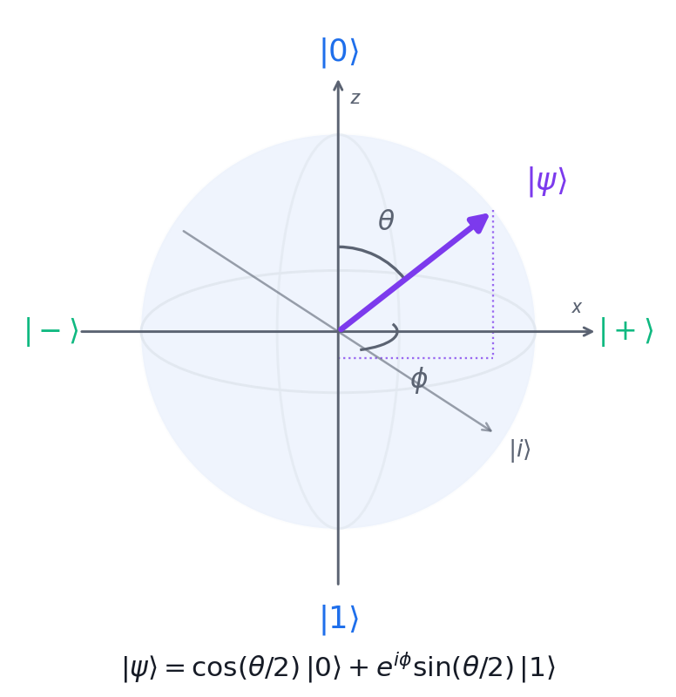
GEOMETRY OF A SINGLE QUBIT
Visualising a Qubit — The Bloch Sphere
North / south poles
|0⟩ and |1⟩ — the classical computational basis states.
The equator
Equal superpositions such as |+⟩ and |−⟩ — maximally uncertain in Z.
θ sets probability
cos²(θ/2) is the chance of measuring 0.
φ sets phase
Invisible to a Z measurement, but it drives interference.
Securing the Future with Quantum Computing and Cryptography · TGS-2024043419
© 2026 Tertiary Infotech Academy Pte Ltd
54

Slide 56
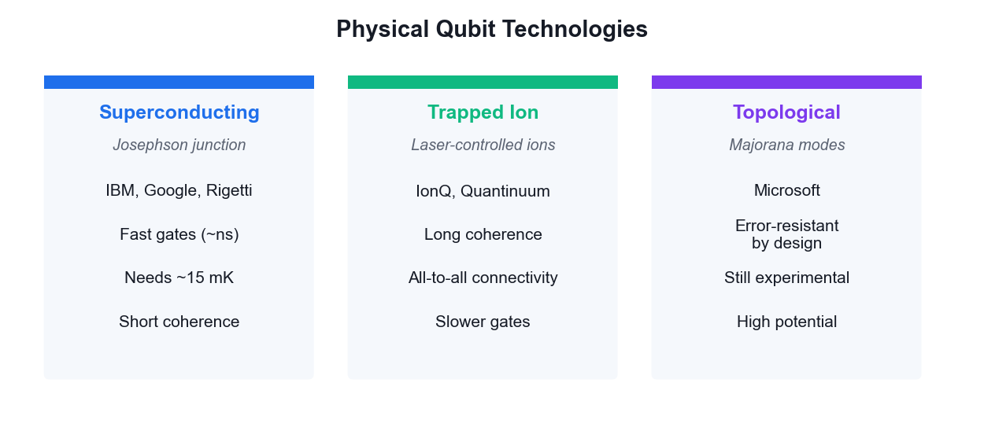
HOW QUBITS ARE ACTUALLY BUILT
Physical Qubit Technologies
No technology has won yet — each trades gate speed against coherence time and connectivity.
Securing the Future with Quantum Computing and Cryptography · TGS-2024043419
© 2026 Tertiary Infotech Academy Pte Ltd
55

Slide 57
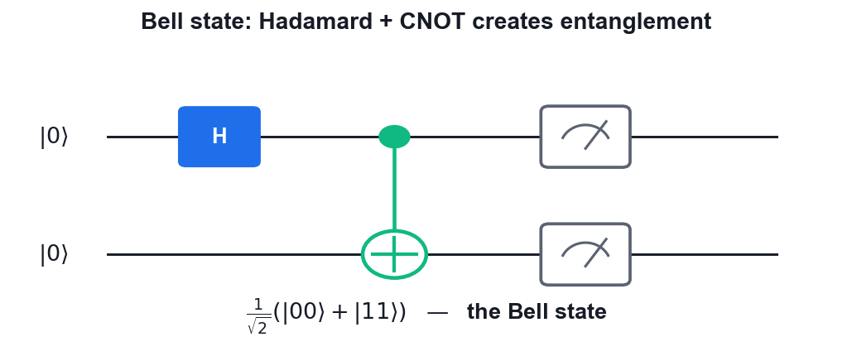
THE MOST IMPORTANT TWO-QUBIT STATE
Entanglement — The Bell State
Two gates
A Hadamard followed by a CNOT is all it takes.
Perfect correlation
Measure 0 on one qubit and the other is certainly 0.
Not separable
The state cannot be written as a product of two single-qubit states.
The resource
Teleportation, superdense coding and QKD all consume entanglement.
Securing the Future with Quantum Computing and Cryptography · TGS-2024043419
© 2026 Tertiary Infotech Academy Pte Ltd
56

Slide 58
WHAT YOU'LL DO
Hands-On Activities — Introduction to Quantum Computing Systems
Activity 2
Activity 3
• Visualising a Qubit on the Bloch Sphere
• Superposition and Entanglement on IBM Quantum
Securing the Future with Quantum Computing and Cryptography · TGS-2024043419
© 2026 Tertiary Infotech Academy Pte Ltd
57

Slide 59
TOPIC 02 · HANDS-ON ACTIVITY
ACTIVITY 2
Visualising a Qubit on the Bloch Sphere
Build single-qubit states in Qiskit and plot them on the Bloch sphere, so you can see how gates rotate a qubit and what superposition and phase actually look like geometrically.
MAPS TO LO2 — Decide on appropriate physical methodologies specific to quantum computing problems
YOU'LL PRODUCE
A set of Bloch-sphere plots showing |0>, |1>, |+>, |-> and an arbitrary Ry-rotated state.
Tools: Qiskit 2.x, matplotlib, Google Colab
Full step-by-step guide: Learner Guide — Activity 2: Visualising a Qubit on the Bloch Sphere
Securing the Future with Quantum Computing and Cryptography · TGS-2024043419
© 2026 Tertiary Infotech Academy Pte Ltd
58

Slide 60
ACTIVITY 2 · VERIFY & DEBRIEF
Visualising a Qubit on the Bloch Sphere
TEST IT — HOW YOU KNOW IT WORKED
|0> sits at the north pole, X moves it to the south pole, H places it on the equator at +x, and the S gate rotates it around the equator while leaving the Z-basis probabilities at 50/50.
DISCUSS WITH YOUR TRAINER
What did the result show?
Why does it work?
Where would you use it?
Restate the outcome in your own words.
Name the quantum principle the activity relies on.
Give one realistic application in your own field.
Securing the Future with Quantum Computing and Cryptography · TGS-2024043419
© 2026 Tertiary Infotech Academy Pte Ltd
59

Slide 61
TOPIC 02 · HANDS-ON ACTIVITY
ACTIVITY 3
Superposition and Entanglement on IBM Quantum
Create your IBM Quantum account, build a superposition circuit and a two-qubit Bell state, and run them on a real quantum processor to see genuine quantum randomness and correlation in the results.
MAPS TO LO2, LO4 — Evaluate quantum computing applicability in the business context
YOU'LL PRODUCE
A Bell state circuit executed on real IBM Quantum hardware, with a measured histogram showing the |00> and |11> correlation.
Tools: IBM Quantum Platform, Qiskit Runtime, Python 3.13
Full step-by-step guide: Learner Guide — Activity 3: Superposition and Entanglement on IBM Quantum
Securing the Future with Quantum Computing and Cryptography · TGS-2024043419
© 2026 Tertiary Infotech Academy Pte Ltd
60

Slide 62
ACTIVITY 3 · VERIFY & DEBRIEF
Superposition and Entanglement on IBM Quantum
TEST IT — HOW YOU KNOW IT WORKED
The superposition circuit gives roughly 50% |0> and 50% |1>; the Bell circuit gives roughly 50% |00> and 50% |11> with only a small percentage of |01> and |10> counts caused by hardware noise.
DISCUSS WITH YOUR TRAINER
What did the result show?
Why does it work?
Where would you use it?
Restate the outcome in your own words.
Name the quantum principle the activity relies on.
Give one realistic application in your own field.
Securing the Future with Quantum Computing and Cryptography · TGS-2024043419
© 2026 Tertiary Infotech Academy Pte Ltd
61

Slide 63
TOPIC RECAP
Recap — Introduction to Quantum Computing Systems
• Qubit vs classical bit
• Bloch sphere
• Physical qubits
• Commercial platforms
• Superposition
• Entanglement
Securing the Future with Quantum Computing and Cryptography · TGS-2024043419
© 2026 Tertiary Infotech Academy Pte Ltd
62

Slide 64
03
TOPIC 03
Quantum Gates and Circuits
Single Qubit Gates · Multi Qubit Gates · Bell and GHZ States · Phase Kickback
Securing the Future with Quantum Computing and Cryptography · TGS-2024043419
© 2026 Tertiary Infotech Academy Pte Ltd
63

Slide 65
MAPS TO LO3, LO5
Key Concepts — Quantum Gates and Circuits
Pauli gates
X (bit flip), Y and Z (phase flip) are self-inverse, Hermitian and unitary — the building blocks of single-qubit logic.
Hadamard gate
H maps |0⟩ → |+⟩ and |1⟩ → |−⟩, creating the equal superposition that starts nearly every quantum algorithm.
1
2
Rotation and phase gates
Rx, Ry, Rz rotate the Bloch vector; S and T are special cases of the phase gate P(θ).
Multi-qubit gates
CNOT, CZ, controlled-phase, SWAP and Toffoli (CCNOT) create the entanglement that makes quantum computing powerful.
3
4
Bell and GHZ states
H followed by CNOT produces a maximally entangled Bell pair; extending to n qubits gives the GHZ state.
Phase kickback
A controlled operation on an eigenstate transfers the eigenvalue phase back to the control qubit — the engine of Deutsch, BV and QPE.
5
6
Securing the Future with Quantum Computing and Cryptography · TGS-2024043419
© 2026 Tertiary Infotech Academy Pte Ltd
64

Slide 66
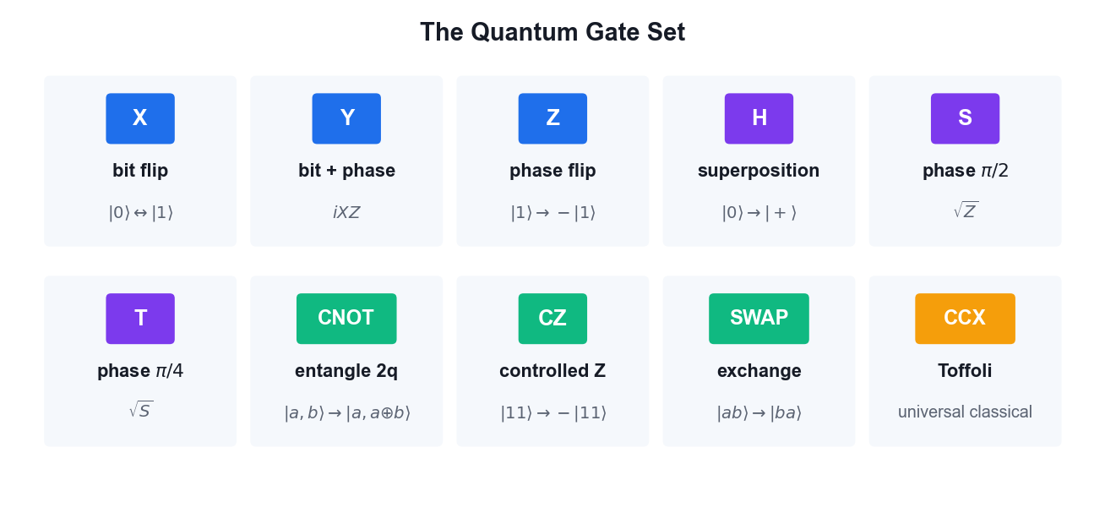
YOUR GATE VOCABULARY
The Quantum Gate Set
Single-qubit gates rotate the Bloch vector; two-qubit gates create the entanglement that makes quantum computing powerful.
Securing the Future with Quantum Computing and Cryptography · TGS-2024043419
© 2026 Tertiary Infotech Academy Pte Ltd
65

Slide 67
GATE REFERENCE
Single vs Multi-Qubit Gates
Gate
Qubits
Effect
Used for
X / Y / Z
1
Rotate π about an axis
Bit flip, phase flip
H
1
Basis change
Create superposition
S / T
1
Phase π/2 and π/4
Fine phase control
Rx / Ry / Rz
1
Arbitrary rotation
Variational ansätze
CNOT
2
Flip target if control is 1
Entanglement, oracles
CZ / CP
2
Conditional phase
QFT, phase kickback
SWAP
2
Exchange two qubits
Routing on hardware
Toffoli
3
Flip if both controls are 1
Reversible classical logic
Securing the Future with Quantum Computing and Cryptography · TGS-2024043419
© 2026 Tertiary Infotech Academy Pte Ltd
66

Slide 68
THE KEY MECHANISM
Phase kickback is the trick behind almost every algorithm.
Apply a controlled-U to an eigenstate of U and the eigenvalue phase appears on the CONTROL qubit — that is how Deutsch, Bernstein-Vazirani, phase estimation and Shor all extract their answers.
Securing the Future with Quantum Computing and Cryptography · TGS-2024043419
© 2026 Tertiary Infotech Academy Pte Ltd
67

Slide 69
DERIVATION
Proof — Phase Kickback
CLAIM
A controlled-U acting on an EIGENSTATE of U leaves the target unchanged and transfers the eigenvalue phase onto the CONTROL qubit.
GIVEN
U is a unitary operator with eigenvector |u> and eigenvalue e^(iθ): U|u> = e^(iθ)|u>.
The control qubit starts in |0>; the target starts in the eigenstate |u>.
CU is the controlled-U gate: it applies U to the target only when the control is |1>.
Securing the Future with Quantum Computing and Cryptography · TGS-2024043419
© 2026 Tertiary Infotech Academy Pte Ltd
68

Slide 70
PHASE KICKBACK · STEP 1 OF 5
Step 1 — Put the control into superposition
Start: |0> (x) |u>
Apply H to the control qubit:
H|0> = (|0> + |1>)/√2
State: (1/√2)( |0> + |1> ) (x) |u>
= (1/√2)( |0>|u> + |1>|u> )
WHY THIS STEP: The control is now in an equal superposition; the target still holds the eigenstate.
Securing the Future with Quantum Computing and Cryptography · TGS-2024043419
© 2026 Tertiary Infotech Academy Pte Ltd
69

Slide 71
PHASE KICKBACK · STEP 2 OF 5
Step 2 — Apply the controlled-U
CU acts term by term (linearity):
CU |0>|u> = |0>|u> (control is 0 -> do nothing)
CU |1>|u> = |1> U|u> (control is 1 -> apply U)
Now use the eigenvalue relation U|u> = e^(iθ)|u>:
CU |1>|u> = |1> e^(iθ)|u> = e^(iθ) |1>|u>
WHY THIS STEP: The scalar e^(iθ) can be moved freely — it multiplies the WHOLE term.
Securing the Future with Quantum Computing and Cryptography · TGS-2024043419
© 2026 Tertiary Infotech Academy Pte Ltd
70

Slide 72
PHASE KICKBACK · STEP 3 OF 5
Step 3 — Collect the terms
State: (1/√2)( |0>|u> + e^(iθ) |1>|u> )
Factor the target |u> out of both terms:
= (1/√2)( |0> + e^(iθ)|1> ) (x) |u>
WHY THIS STEP: This factorisation is the heart of the proof — the state is SEPARABLE again.
Securing the Future with Quantum Computing and Cryptography · TGS-2024043419
© 2026 Tertiary Infotech Academy Pte Ltd
71

Slide 73
PHASE KICKBACK · STEP 4 OF 5
Step 4 — Read off the result
Target register: |u> — UNCHANGED
Control register: (|0> + e^(iθ)|1>)/√2
The phase e^(iθ), which belonged to the TARGET's eigenvalue,
now sits as a RELATIVE PHASE on the CONTROL qubit.
WHY THIS STEP: The information moved from the target to the control without the target changing.
Securing the Future with Quantum Computing and Cryptography · TGS-2024043419
© 2026 Tertiary Infotech Academy Pte Ltd
72

Slide 74
PHASE KICKBACK · STEP 5 OF 5
Step 5 — The oracle special case
Take U = X (the NOT gate) and |u> = |-> = (|0> - |1>)/√2.
Check it is an eigenstate: X|-> = (X|0> - X|1>)/√2
= (|1> - |0>)/√2
= -(|0> - |1>)/√2 = (-1)|->
So |-> is an eigenvector of X with eigenvalue -1, i.e. e^(iπ).
For an oracle U_f: |x>|y> -> |x>|y ⊕ f(x)>, setting the target to |->:
U_f |x>|-> = (-1)^f(x) |x>|->
WHY THIS STEP: This is THE identity that powers Deutsch, Deutsch-Jozsa, Bernstein-Vazirani, Grover's oracle and quantum phase estimation.
Securing the Future with Quantum Computing and Cryptography · TGS-2024043419
© 2026 Tertiary Infotech Academy Pte Ltd
73

Slide 75
QED
Phase Kickback — Result
RESULT
Controlled-U on an eigenstate |u> gives (|0> + e^(iθ)|1>)/√2 (x) |u> — the eigenvalue phase is 'kicked back' onto the control. With U = X and target |->, the oracle marks inputs with the sign (-1)^f(x).
WHY IT MATTERS
Measurement cannot see a GLOBAL phase, but a RELATIVE phase on the control is converted into a measurable amplitude by a final Hadamard. Phase kickback is how a quantum computer extracts a global property of f without evaluating f at every input.
Securing the Future with Quantum Computing and Cryptography · TGS-2024043419
© 2026 Tertiary Infotech Academy Pte Ltd
74

Slide 76
WHAT YOU'LL DO
Hands-On Activities — Quantum Gates and Circuits
Activity 4
Activity 5
• Building Circuits in IBM Quantum Composer
• Quantum Gates and Bell/GHZ States with PennyLane
Securing the Future with Quantum Computing and Cryptography · TGS-2024043419
© 2026 Tertiary Infotech Academy Pte Ltd
75

Slide 77
TOPIC 03 · HANDS-ON ACTIVITY
ACTIVITY 4
Building Circuits in IBM Quantum Composer
Use the drag-and-drop IBM Quantum Composer to build single- and multi-qubit circuits, watch the state vector and probability panels update live, and export the circuit as OpenQASM.
MAPS TO LO5 — Spearhead the application of quantum gates to quantum computing domains
YOU'LL PRODUCE
A set of Composer circuits (X, H, CNOT, Bell state) with their statevector output, exported as OpenQASM 3 code.
Tools: IBM Quantum Composer, OpenQASM 3
Full step-by-step guide: Learner Guide — Activity 4: Building Circuits in IBM Quantum Composer
Securing the Future with Quantum Computing and Cryptography · TGS-2024043419
© 2026 Tertiary Infotech Academy Pte Ltd
76

Slide 78
ACTIVITY 4 · VERIFY & DEBRIEF
Building Circuits in IBM Quantum Composer
TEST IT — HOW YOU KNOW IT WORKED
The Composer probability panel shows a 50/50 split between |00> and |11> for the Bell circuit, and the exported OpenQASM contains an h instruction followed by a cx instruction.
DISCUSS WITH YOUR TRAINER
What did the result show?
Why does it work?
Where would you use it?
Restate the outcome in your own words.
Name the quantum principle the activity relies on.
Give one realistic application in your own field.
Securing the Future with Quantum Computing and Cryptography · TGS-2024043419
© 2026 Tertiary Infotech Academy Pte Ltd
77

Slide 79
TOPIC 03 · HANDS-ON ACTIVITY
ACTIVITY 5
Quantum Gates and Bell/GHZ States with PennyLane
Use PennyLane's quantum-function and QNode model to apply the full single- and multi-qubit gate set, then construct Bell and GHZ entangled states and verify their measurement correlations.
MAPS TO LO3, LO5 — Direct two-level quantum models and apply quantum gates
YOU'LL PRODUCE
A PennyLane script that draws each circuit, returns the state vector, and confirms the Bell and GHZ correlations.
Tools: PennyLane, Python 3.13, matplotlib
Full step-by-step guide: Learner Guide — Activity 5: Quantum Gates and Bell/GHZ States with PennyLane
Securing the Future with Quantum Computing and Cryptography · TGS-2024043419
© 2026 Tertiary Infotech Academy Pte Ltd
78

Slide 80
ACTIVITY 5 · VERIFY & DEBRIEF
Quantum Gates and Bell/GHZ States with PennyLane
TEST IT — HOW YOU KNOW IT WORKED
The Bell state returns amplitudes of about 0.707 on |00> and |11> and zero elsewhere; the GHZ state returns amplitudes only on |000> and |111>; the phase-kickback circuit shows the eigenvalue phase transferred to the control qubit.
DISCUSS WITH YOUR TRAINER
What did the result show?
Why does it work?
Where would you use it?
Restate the outcome in your own words.
Name the quantum principle the activity relies on.
Give one realistic application in your own field.
Securing the Future with Quantum Computing and Cryptography · TGS-2024043419
© 2026 Tertiary Infotech Academy Pte Ltd
79

Slide 81
TOPIC RECAP
Recap — Quantum Gates and Circuits
• Pauli gates
• Hadamard gate
• Rotation and phase gates
• Multi-qubit gates
• Bell and GHZ states
• Phase kickback
Securing the Future with Quantum Computing and Cryptography · TGS-2024043419
© 2026 Tertiary Infotech Academy Pte Ltd
80

Slide 82
04
TOPIC 04
Quantum Protocols
No-Cloning Theorem · Teleportation · Superdense Coding · BB84 QKD · CHSH Game
Securing the Future with Quantum Computing and Cryptography · TGS-2024043419
© 2026 Tertiary Infotech Academy Pte Ltd
81

Slide 83
MAPS TO LO3, LO7
Key Concepts — Quantum Protocols
No-cloning theorem
No unitary can copy an arbitrary unknown quantum state — proved by linearity, and the foundation of quantum key security.
Quantum teleportation
Transfers an unknown qubit state using one shared Bell pair plus two classical bits — no faster-than-light signalling.
1
2
Superdense coding
The dual of teleportation: send two classical bits by transmitting a single qubit of a pre-shared entangled pair.
BB84 QKD
Alice and Bob build a shared secret key using random bases; eavesdropping disturbs the states and raises the error rate.
3
4
Eavesdropping detection
An intercept-resend attack introduces roughly a 25% error rate in the sifted key, revealing Eve's presence.
CHSH game
A quantum strategy using entanglement wins ~85% of the time versus the classical maximum of 75%, disproving local hidden variables.
5
6
Securing the Future with Quantum Computing and Cryptography · TGS-2024043419
© 2026 Tertiary Infotech Academy Pte Ltd
82

Slide 84
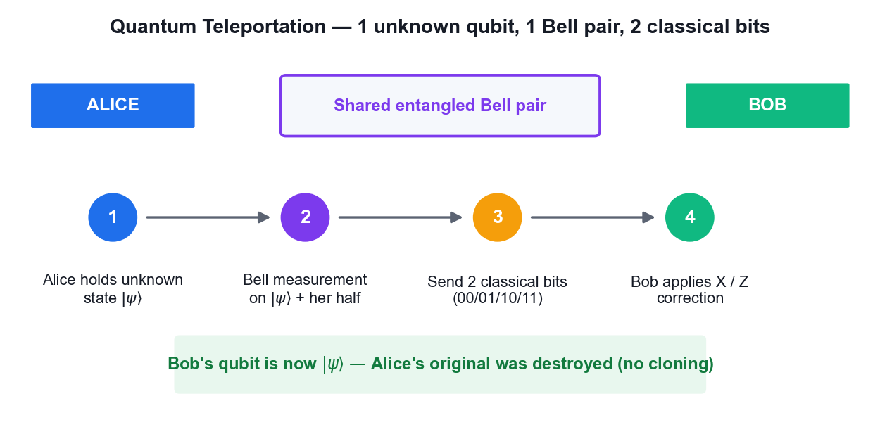
MOVING A STATE WITHOUT MOVING A PARTICLE
Quantum Teleportation
Two classical bits must still travel — so teleportation never beats the speed of light.
Securing the Future with Quantum Computing and Cryptography · TGS-2024043419
© 2026 Tertiary Infotech Academy Pte Ltd
83

Slide 85
TWO SIDES OF ONE COIN
Teleportation vs Superdense Coding
Qubit → classical channel
Classical → qubit channel
• Quantum Teleportation
– Sends: 1 unknown QUBIT state
– Costs: 1 Bell pair + 2 classical bits
– Original is destroyed (no cloning)
– Use: moving quantum data
• Superdense Coding
– Sends: 2 CLASSICAL bits
– Costs: 1 Bell pair + 1 transmitted qubit
– Encode with I, X, Z or ZX
– Use: doubling channel capacity
Securing the Future with Quantum Computing and Cryptography · TGS-2024043419
© 2026 Tertiary Infotech Academy Pte Ltd
84

Slide 86
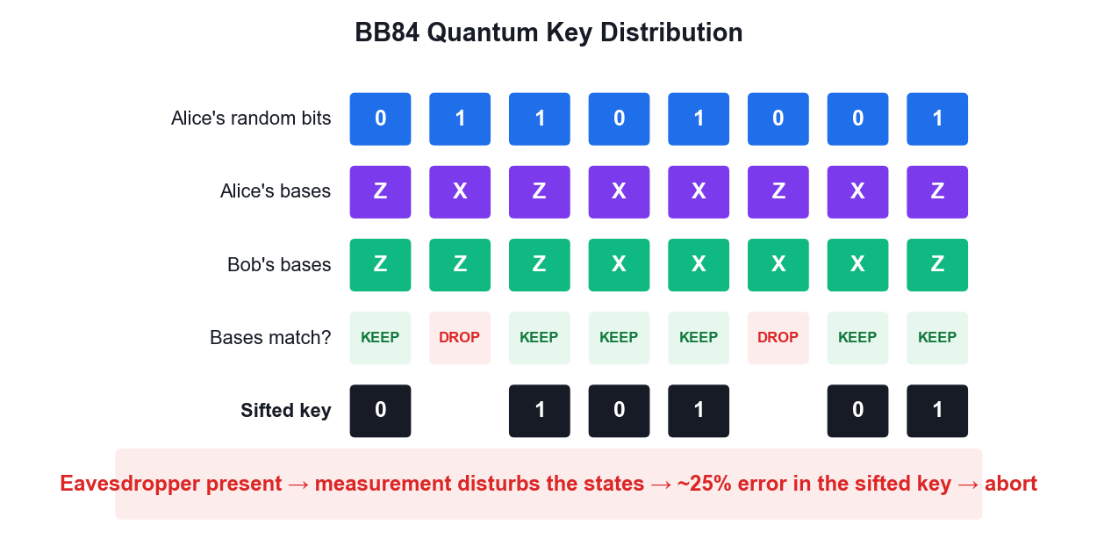
SECURITY FROM PHYSICS, NOT MATHS
BB84 Quantum Key Distribution
Security rests on the no-cloning theorem — an eavesdropper cannot copy the qubits without disturbing them.
Securing the Future with Quantum Computing and Cryptography · TGS-2024043419
© 2026 Tertiary Infotech Academy Pte Ltd
85

Slide 87
DERIVATION
Proof — Quantum Teleportation
CLAIM
An unknown qubit state can be transferred using one shared Bell pair and two classical bits — without ever measuring or copying the state itself.
GIVEN
Alice holds an unknown qubit |ψ> = a|0> + b|1>, with |a|² + |b|² = 1.
Alice and Bob share the Bell pair |Φ+> = (|00> + |11>)/√2.
Qubit ordering: q0 = Alice's unknown state, q1 = Alice's half, q2 = Bob's half.
Neither party knows a or b — and neither learns them at any point.
Securing the Future with Quantum Computing and Cryptography · TGS-2024043419
© 2026 Tertiary Infotech Academy Pte Ltd
86

Slide 88
QUANTUM TELEPORTATION · STEP 1 OF 7
Step 1 — Write the full three-qubit state
|Ψ₀> = |ψ>₀ (x) |Φ+>₁₂
= (a|0> + b|1>) (x) (|00> + |11>)/√2
Expand:
= (1/√2)( a|000> + a|011> + b|100> + b|111> )
WHY THIS STEP: Three qubits, so the state space has 2³ = 8 dimensions; four terms are populated.
Securing the Future with Quantum Computing and Cryptography · TGS-2024043419
© 2026 Tertiary Infotech Academy Pte Ltd
87

Slide 89
QUANTUM TELEPORTATION · STEP 2 OF 7
Step 2 — Alice applies CNOT (q0 -> q1)
CNOT flips q1 when q0 = 1. Term by term:
a|000> -> a|000> (q0=0, unchanged)
a|011> -> a|011> (q0=0, unchanged)
b|100> -> b|110> (q0=1, flip q1)
b|111> -> b|101> (q0=1, flip q1)
|Ψ₁> = (1/√2)( a|000> + a|011> + b|110> + b|101> )
WHY THIS STEP: This begins Alice's Bell-basis measurement — CNOT then H rotates the Bell basis into the computational basis.
Securing the Future with Quantum Computing and Cryptography · TGS-2024043419
© 2026 Tertiary Infotech Academy Pte Ltd
88

Slide 90
QUANTUM TELEPORTATION · STEP 3 OF 7
Step 3 — Alice applies H to q0
H|0> = (|0>+|1>)/√2 , H|1> = (|0>-|1>)/√2. Substituting:
|Ψ₂> = (1/2)[ a(|0>+|1>)|00> + a(|0>+|1>)|11>
+ b(|0>-|1>)|10> + b(|0>-|1>)|01> ]
WHY THIS STEP: Now expand and regroup by Alice's two qubits (q0 q1) — the next step.
Securing the Future with Quantum Computing and Cryptography · TGS-2024043419
© 2026 Tertiary Infotech Academy Pte Ltd
89

Slide 91
QUANTUM TELEPORTATION · STEP 4 OF 7
Step 4 — Regroup by Alice's measurement outcome
Collecting terms with the same q0q1 prefix:
|Ψ₂> = (1/2) [ |00>(a|0> + b|1>)
+ |01>(a|1> + b|0>)
+ |10>(a|0> - b|1>)
+ |11>(a|1> - b|0>) ]
WHY THIS STEP: THIS IS THE KEY LINE. Bob's qubit is already |ψ> up to a known correction, in every branch.
Securing the Future with Quantum Computing and Cryptography · TGS-2024043419
© 2026 Tertiary Infotech Academy Pte Ltd
90

Slide 92
QUANTUM TELEPORTATION · STEP 5 OF 7
Step 5 — Alice measures; Bob's state collapses
Each outcome has probability |1/2|² = 1/4 — independent of a and b.
00 -> Bob has a|0> + b|1> = |ψ>
01 -> Bob has a|1> + b|0> = X|ψ>
10 -> Bob has a|0> - b|1> = Z|ψ>
11 -> Bob has a|1> - b|0> = XZ|ψ> (up to phase)
WHY THIS STEP: Because every outcome is equally likely REGARDLESS of a and b, Alice's measurement reveals nothing about the state — this is why no information leaks.
Securing the Future with Quantum Computing and Cryptography · TGS-2024043419
© 2026 Tertiary Infotech Academy Pte Ltd
91

Slide 93
QUANTUM TELEPORTATION · STEP 6 OF 7
Step 6 — Bob applies the correction
Alice sends the two classical bits (b₀b₁). Bob applies:
00 -> I (do nothing) -> |ψ>
01 -> X -> X·X|ψ> = |ψ>
10 -> Z -> Z·Z|ψ> = |ψ>
11 -> ZX -> |ψ>
using X² = Z² = I.
WHY THIS STEP: In every branch Bob ends holding exactly a|0> + b|1>.
Securing the Future with Quantum Computing and Cryptography · TGS-2024043419
© 2026 Tertiary Infotech Academy Pte Ltd
92

Slide 94
QUANTUM TELEPORTATION · STEP 7 OF 7
Step 7 — Consistency checks
NO CLONING
Alice's q0 was measured, so her copy is destroyed.
Only ONE |ψ> exists at the end — no cloning occurred.
NO FASTER-THAN-LIGHT SIGNALLING
Before the classical bits arrive, Bob's qubit is the maximally
mixed state ρ = I/2 — it carries no information at all.
The two classical bits travel at or below light speed.
NO STATE KNOWLEDGE
Neither party ever learns the amplitudes a or b.
WHY THIS STEP: Teleportation respects both quantum and relativistic limits.
Securing the Future with Quantum Computing and Cryptography · TGS-2024043419
© 2026 Tertiary Infotech Academy Pte Ltd
93

Slide 95
QED
Quantum Teleportation — Result
RESULT
Bob's qubit is exactly |ψ> = a|0> + b|1> after applying the correction indicated by Alice's two classical bits. The original was destroyed by the measurement.
WHY IT MATTERS
Teleportation is the foundation of quantum networking and the quantum internet, and is used inside fault-tolerant architectures to move logical qubits between code blocks. It shows entanglement + classical communication can substitute for sending a qubit.
Securing the Future with Quantum Computing and Cryptography · TGS-2024043419
© 2026 Tertiary Infotech Academy Pte Ltd
94

Slide 96
DERIVATION
Proof — The No-Cloning Theorem
CLAIM
No unitary operation can copy an arbitrary unknown quantum state.
GIVEN
Suppose a cloning machine U exists with U(|ψ>|0>) = |ψ>|ψ> for EVERY state |ψ>.
|0> is a blank slate; |ψ> is the state to copy.
We derive a contradiction — this is a proof by contradiction.
Securing the Future with Quantum Computing and Cryptography · TGS-2024043419
© 2026 Tertiary Infotech Academy Pte Ltd
95

Slide 97
THE NO-CLONING THEOREM · STEP 1 OF 5
Step 1 — Assume two arbitrary states
Let |ψ> and |φ> be any two states. By assumption:
U(|ψ>|0>) = |ψ>|ψ>
U(|φ>|0>) = |φ>|φ>
WHY THIS STEP: No restriction yet — this is just the definition of a universal cloner.
Securing the Future with Quantum Computing and Cryptography · TGS-2024043419
© 2026 Tertiary Infotech Academy Pte Ltd
96

Slide 98
THE NO-CLONING THEOREM · STEP 2 OF 5
Step 2 — Unitary preserves inner products
For any unitary U: <Uα|Uβ> = <α|U†U|β> = <α|I|β> = <α|β>
Apply this to our two inputs:
LHS = <ψ|φ> · <0|0> = <ψ|φ>
RHS = <ψ|φ> · <ψ|φ> = <ψ|φ>²
WHY THIS STEP: Unitarity is the only physical assumption used — this is why the theorem is so general.
Securing the Future with Quantum Computing and Cryptography · TGS-2024043419
© 2026 Tertiary Infotech Academy Pte Ltd
97

Slide 99
THE NO-CLONING THEOREM · STEP 3 OF 5
Step 3 — Solve the resulting equation
Setting LHS = RHS and writing z = <ψ|φ>:
z = z²
z² - z = 0
z(z - 1) = 0
So either z = 0 or z = 1.
WHY THIS STEP: Only two possibilities survive.
Securing the Future with Quantum Computing and Cryptography · TGS-2024043419
© 2026 Tertiary Infotech Academy Pte Ltd
98

Slide 100
THE NO-CLONING THEOREM · STEP 4 OF 5
Step 4 — Interpret the two solutions
z = <ψ|φ> = 1 => |ψ> and |φ> are the SAME state.
z = <ψ|φ> = 0 => |ψ> and |φ> are ORTHOGONAL.
But we assumed U clones ARBITRARY states — including states that are
neither identical nor orthogonal, e.g. |0> and |+>, where <0|+> = 1/√2.
1/√2 is neither 0 nor 1 -> CONTRADICTION.
WHY THIS STEP: The assumption fails for any pair of non-orthogonal, non-identical states.
Securing the Future with Quantum Computing and Cryptography · TGS-2024043419
© 2026 Tertiary Infotech Academy Pte Ltd
99

Slide 101
THE NO-CLONING THEOREM · STEP 5 OF 5
Step 5 — Conclusion
No unitary can clone an arbitrary unknown state.
What IS possible:
• copying states known to be from an ORTHOGONAL set (classical copying)
• MOVING a state (teleportation — the original is destroyed)
• approximate cloning with bounded fidelity (max ~5/6 for a universal cloner)
WHY THIS STEP: Note the theorem forbids perfect copying of UNKNOWN states — classical bits, which are always in an orthogonal set, remain copyable.
Securing the Future with Quantum Computing and Cryptography · TGS-2024043419
© 2026 Tertiary Infotech Academy Pte Ltd
100

Slide 102
QED
The No-Cloning Theorem — Result
RESULT
Perfect cloning of an arbitrary unknown quantum state is impossible — it would violate the linearity/unitarity of quantum mechanics.
WHY IT MATTERS
No-cloning is the security foundation of QKD: an eavesdropper cannot copy the qubits in transit and must instead measure them, which disturbs the state and reveals her presence. It is also why quantum error correction cannot work by simple redundancy.
Securing the Future with Quantum Computing and Cryptography · TGS-2024043419
© 2026 Tertiary Infotech Academy Pte Ltd
101

Slide 103
DERIVATION
Proof — BB84 Security and Eavesdropper Detection
CLAIM
An intercept-resend eavesdropper introduces a 25% error rate in the sifted key and is therefore detected with near-certainty.
GIVEN
Two conjugate bases: Z = {|0>, |1>} and X = {|+>, |->}.
Encoding: bit 0 -> |0> or |+> ; bit 1 -> |1> or |-> (basis chosen at random).
The bases are UNBIASED: |<0|+>|² = |<0|->|² = |<1|+>|² = |<1|->|² = 1/2.
Alice and Bob each choose their basis independently and uniformly at random.
Securing the Future with Quantum Computing and Cryptography · TGS-2024043419
© 2026 Tertiary Infotech Academy Pte Ltd
102

Slide 104
BB84 SECURITY AND EAVESDROPPER DETECTION · STEP 1 OF 6
Step 1 — Sifting (no eavesdropper)
Alice sends n qubits. Bob measures each in a random basis.
P(bases match) = 1/2, so about n/2 qubits survive sifting.
When the bases MATCH, Bob's measurement is deterministic:
Alice sends |0> in Z, Bob measures Z -> gets 0 with probability 1
So the sifted key agrees perfectly (up to channel noise).
WHY THIS STEP: The bits where the bases differed are publicly discarded — they carry no key.
Securing the Future with Quantum Computing and Cryptography · TGS-2024043419
© 2026 Tertiary Infotech Academy Pte Ltd
103

Slide 105
BB84 SECURITY AND EAVESDROPPER DETECTION · STEP 2 OF 6
Step 2 — Eve intercepts and resends
Eve does not know Alice's basis, so she guesses:
P(Eve picks the right basis) = 1/2
CASE 1 — Eve guesses RIGHT (prob 1/2):
She measures correctly, resends the same state.
Bob (same basis as Alice) gets the right bit. NO error introduced.
WHY THIS STEP: Half the time Eve is invisible on that qubit.
Securing the Future with Quantum Computing and Cryptography · TGS-2024043419
© 2026 Tertiary Infotech Academy Pte Ltd
104

Slide 106
BB84 SECURITY AND EAVESDROPPER DETECTION · STEP 3 OF 6
Step 3 — Eve guesses the WRONG basis
CASE 2 — Eve guesses WRONG (prob 1/2):
Say Alice sent |0> (Z basis) but Eve measures in X.
|0> = (|+> + |->)/√2
Eve gets |+> or |-> with probability 1/2 each — and RESENDS that.
Bob now measures in Z (matching Alice). Say Eve resent |+>:
|+> = (|0> + |1>)/√2
Bob gets 0 or 1 with probability 1/2 each.
-> Bob's bit is WRONG with probability 1/2.
WHY THIS STEP: Eve's wrong-basis measurement has destroyed the original state. She cannot restore it — that is the no-cloning theorem doing the work.
Securing the Future with Quantum Computing and Cryptography · TGS-2024043419
© 2026 Tertiary Infotech Academy Pte Ltd
105

Slide 107
BB84 SECURITY AND EAVESDROPPER DETECTION · STEP 4 OF 6
Step 4 — Compute the total error rate
P(error) = P(Eve wrong basis) × P(Bob then errs)
= 1/2 × 1/2
= 1/4 = 25%
So on the sifted key, roughly 1 bit in 4 disagrees between Alice and Bob.
WHY THIS STEP: This 25% figure — the Quantum Bit Error Rate (QBER) — is the signature of intercept-resend.
Securing the Future with Quantum Computing and Cryptography · TGS-2024043419
© 2026 Tertiary Infotech Academy Pte Ltd
106

Slide 108
BB84 SECURITY AND EAVESDROPPER DETECTION · STEP 5 OF 6
Step 5 — Detection probability
Alice and Bob publicly compare a random sample of m sifted bits.
P(a given compared bit fails to reveal Eve) = 1 - 1/4 = 3/4
P(Eve escapes detection over m bits) = (3/4)^m
m = 10 -> 5.6% escape chance
m = 50 -> 0.000006%
m = 100 -> ~3 × 10⁻¹³
WHY THIS STEP: Detection probability rises exponentially with the size of the test sample.
Securing the Future with Quantum Computing and Cryptography · TGS-2024043419
© 2026 Tertiary Infotech Academy Pte Ltd
107

Slide 109
BB84 SECURITY AND EAVESDROPPER DETECTION · STEP 6 OF 6
Step 6 — Decision rule and post-processing
Alice and Bob measure the QBER on the test sample:
QBER below threshold (~11%) -> proceed:
• error correction (reconcile the remaining differences)
• privacy amplification (hash down to a shorter, secure key)
QBER above threshold -> ABORT and discard the key
The discarded test bits are never reused as key material.
WHY THIS STEP: Real systems tolerate a few percent QBER from hardware noise; the threshold separates tolerable noise from an active attack.
Securing the Future with Quantum Computing and Cryptography · TGS-2024043419
© 2026 Tertiary Infotech Academy Pte Ltd
108

Slide 110
QED
BB84 Security and Eavesdropper Detection — Result
RESULT
Intercept-resend produces a 25% QBER. Comparing 100 random sifted bits detects Eve with probability 1 - (3/4)¹⁰⁰ ≈ 1 - 3×10⁻¹³.
WHY IT MATTERS
BB84's security rests on PHYSICS (no-cloning + measurement disturbance), not on a computational hardness assumption. A quantum computer does not weaken it — unlike RSA and ECC, which Shor's algorithm breaks outright.
Securing the Future with Quantum Computing and Cryptography · TGS-2024043419
© 2026 Tertiary Infotech Academy Pte Ltd
109

Slide 111
DERIVATION
Proof — The CHSH Inequality and Bell Violation
CLAIM
Local hidden-variable theories obey |S| ≤ 2, but quantum mechanics reaches 2√2 ≈ 2.828.
GIVEN
Alice measures A₀ or A₁; Bob measures B₀ or B₁. Each outcome is ±1.
The CHSH quantity: S = <A₀B₀> + <A₀B₁> + <A₁B₀> - <A₁B₁>.
LOCAL REALISM assumes each measurement has a definite pre-existing value.
Securing the Future with Quantum Computing and Cryptography · TGS-2024043419
© 2026 Tertiary Infotech Academy Pte Ltd
110

Slide 112
THE CHSH INEQUALITY AND BELL VIOLATION · STEP 1 OF 4
Step 1 — The classical bound
Under local realism every a₀,a₁,b₀,b₁ ∈ {+1,-1} exists simultaneously.
S = a₀b₀ + a₀b₁ + a₁b₀ - a₁b₁
= a₀(b₀ + b₁) + a₁(b₀ - b₁)
Since b₀,b₁ = ±1, one of (b₀+b₁), (b₀-b₁) is 0 and the other is ±2.
So S = ±2 in every case, hence |S| ≤ 2.
WHY THIS STEP: This is the CHSH inequality. It assumes ONLY locality and realism — no physics beyond that.
Securing the Future with Quantum Computing and Cryptography · TGS-2024043419
© 2026 Tertiary Infotech Academy Pte Ltd
111

Slide 113
THE CHSH INEQUALITY AND BELL VIOLATION · STEP 2 OF 4
Step 2 — The quantum prediction
Take the singlet |Ψ-> = (|01> - |10>)/√2.
For measurement directions a and b, quantum mechanics predicts:
<A(a)B(b)> = -cos(θ_ab)
where θ_ab is the angle between the two measurement axes.
WHY THIS STEP: This correlation is derived from the Born rule alone.
Securing the Future with Quantum Computing and Cryptography · TGS-2024043419
© 2026 Tertiary Infotech Academy Pte Ltd
112

Slide 114
THE CHSH INEQUALITY AND BELL VIOLATION · STEP 3 OF 4
Step 3 — Choose the optimal angles
Pick A₀ = 0°, A₁ = 45°, B₀ = 22.5°, B₁ = 67.5°. Then:
<A₀B₀> = -cos(22.5°) = -0.9239
<A₀B₁> = -cos(67.5°) = -0.3827
<A₁B₀> = -cos(22.5°) = -0.9239
<A₁B₁> = -cos(22.5°) = -0.9239 (angle 22.5° the other way)
|S| = |−0.9239 − 0.3827 − 0.9239 + 0.9239| … = 2√2 ≈ 2.828
WHY THIS STEP: 2√2 is the Tsirelson bound — the maximum quantum mechanics allows.
Securing the Future with Quantum Computing and Cryptography · TGS-2024043419
© 2026 Tertiary Infotech Academy Pte Ltd
113

Slide 115
THE CHSH INEQUALITY AND BELL VIOLATION · STEP 4 OF 4
Step 4 — What the violation means
Classical (local realism): |S| ≤ 2
Quantum mechanics: |S| = 2√2 ≈ 2.828
Experiment (Aspect 1982, loophole-free 2015): ~2.4-2.8
Nature VIOLATES the classical bound. Therefore no local hidden-variable
theory can reproduce quantum mechanics.
2022 Nobel Prize: Aspect, Clauser and Zeilinger.
WHY THIS STEP: Entanglement is not 'hidden classical correlation' — it is a genuinely non-classical resource.
Securing the Future with Quantum Computing and Cryptography · TGS-2024043419
© 2026 Tertiary Infotech Academy Pte Ltd
114

Slide 116
QED
The CHSH Inequality and Bell Violation — Result
RESULT
Local hidden variables force |S| ≤ 2; entangled qubits achieve 2√2. Experiments confirm the quantum value, ruling out local realism.
WHY IT MATTERS
The CHSH violation is the basis of DEVICE-INDEPENDENT cryptography: if your devices violate the inequality, entanglement is genuine and a key can be certified secure even with untrusted hardware. It also underpins the E91 QKD protocol.
Securing the Future with Quantum Computing and Cryptography · TGS-2024043419
© 2026 Tertiary Infotech Academy Pte Ltd
115

Slide 117
DERIVATION
Proof — Superdense Coding
CLAIM
One qubit of a pre-shared entangled pair carries TWO classical bits.
GIVEN
Alice and Bob share |Φ+> = (|00> + |11>)/√2 in advance.
Alice wants to send a 2-bit message; she may transmit only ONE qubit.
The four Bell states form an orthonormal basis of the 2-qubit space.
Securing the Future with Quantum Computing and Cryptography · TGS-2024043419
© 2026 Tertiary Infotech Academy Pte Ltd
116

Slide 118
SUPERDENSE CODING · STEP 1 OF 4
Step 1 — Alice encodes with a local operation
Alice applies one gate to HER qubit only:
message 00 -> I -> (|00> + |11>)/√2 = |Φ+>
message 01 -> X -> (|10> + |01>)/√2 = |Ψ+>
message 10 -> Z -> (|00> - |11>)/√2 = |Φ->
message 11 -> ZX -> (|10> - |01>)/√2 = |Ψ->
WHY THIS STEP: Alice never touches Bob's qubit — yet the GLOBAL state changes, because the pair is entangled.
Securing the Future with Quantum Computing and Cryptography · TGS-2024043419
© 2026 Tertiary Infotech Academy Pte Ltd
117

Slide 119
SUPERDENSE CODING · STEP 2 OF 4
Step 2 — The four results are orthogonal
<Φ+|Φ-> = 0, <Φ+|Ψ+> = 0, <Φ+|Ψ-> = 0, and so on.
All four Bell states are mutually ORTHOGONAL, so they can be
distinguished perfectly by a single measurement in the Bell basis.
WHY THIS STEP: Orthogonality is exactly what makes perfect discrimination possible — contrast with BB84, where non-orthogonal states protect the key.
Securing the Future with Quantum Computing and Cryptography · TGS-2024043419
© 2026 Tertiary Infotech Academy Pte Ltd
118

Slide 120
SUPERDENSE CODING · STEP 3 OF 4
Step 3 — Bob decodes
Alice sends her single qubit to Bob. He now holds both and undoes the
entangling circuit:
CNOT (control = Alice's qubit, target = Bob's), then H on Alice's qubit
|Φ+> -> |00> |Ψ+> -> |01>
|Φ-> -> |10> |Ψ-> -> |11>
Bob measures both qubits and reads the 2-bit message.
WHY THIS STEP: The Bell measurement maps the four Bell states back to the computational basis.
Securing the Future with Quantum Computing and Cryptography · TGS-2024043419
© 2026 Tertiary Infotech Academy Pte Ltd
119

Slide 121
SUPERDENSE CODING · STEP 4 OF 4
Step 4 — Accounting and limits
Total qubits transmitted: 1. Classical bits delivered: 2.
This does NOT violate Holevo's bound: the entangled pair had to be
distributed in advance, which itself required sending a qubit.
Superdense coding is the DUAL of teleportation:
teleportation: 2 classical bits + 1 ebit -> 1 qubit
superdense coding: 1 qubit + 1 ebit -> 2 classical bits
WHY THIS STEP: Entanglement is a RESOURCE that can be traded against communication.
Securing the Future with Quantum Computing and Cryptography · TGS-2024043419
© 2026 Tertiary Infotech Academy Pte Ltd
120

Slide 122
QED
Superdense Coding — Result
RESULT
Alice transmits two classical bits by sending a single qubit, using a pre-shared entangled pair and a local Pauli operation.
WHY IT MATTERS
Superdense coding proved entanglement has quantitative communication value, launching quantum information theory as a discipline and motivating entanglement-distribution networks.
Securing the Future with Quantum Computing and Cryptography · TGS-2024043419
© 2026 Tertiary Infotech Academy Pte Ltd
121

Slide 123
WHAT YOU'LL DO
Hands-On Activities — Quantum Protocols
Activity 6
Activity 7
Activity 8
• Quantum Teleportation
• Superdense Coding Protocol
• BB84 Quantum Key Distribution with Eavesdropping Detection
Securing the Future with Quantum Computing and Cryptography · TGS-2024043419
© 2026 Tertiary Infotech Academy Pte Ltd
122

Slide 124
TOPIC 04 · HANDS-ON ACTIVITY
ACTIVITY 6
Quantum Teleportation
Implement the three-qubit teleportation protocol: entangle a shared pair, perform a Bell measurement on the unknown state, and apply the conditional corrections that recreate the original state on Bob's qubit.
MAPS TO LO3, LO7 — Synthesize quantum methodologies to address complex problems
YOU'LL PRODUCE
A teleportation circuit run on IBM Quantum hardware that reconstructs an arbitrary input state at the receiving qubit.
Tools: Qiskit 2.x, IBM Quantum Runtime, OpenQASM
Full step-by-step guide: Learner Guide — Activity 6: Quantum Teleportation
Securing the Future with Quantum Computing and Cryptography · TGS-2024043419
© 2026 Tertiary Infotech Academy Pte Ltd
123

Slide 125
ACTIVITY 6 · VERIFY & DEBRIEF
Quantum Teleportation
TEST IT — HOW YOU KNOW IT WORKED
The measurement statistics on Bob's qubit q2 match the amplitudes of the state originally prepared on q0, within hardware noise, and the original state no longer exists on q0.
DISCUSS WITH YOUR TRAINER
What did the result show?
Why does it work?
Where would you use it?
Restate the outcome in your own words.
Name the quantum principle the activity relies on.
Give one realistic application in your own field.
Securing the Future with Quantum Computing and Cryptography · TGS-2024043419
© 2026 Tertiary Infotech Academy Pte Ltd
124

Slide 126
TOPIC 04 · HANDS-ON ACTIVITY
ACTIVITY 7
Superdense Coding Protocol
Implement the dual of teleportation: transmit two classical bits by sending only a single qubit of a pre-shared entangled pair, encoding the message with the I, X, Z and XZ operations.
MAPS TO LO3, LO7 — Direct two-level quantum models for quantum computing
YOU'LL PRODUCE
A superdense coding circuit that correctly transmits all four two-bit messages 00, 01, 10 and 11.
Tools: Qiskit 2.x, IBM Quantum Runtime
Full step-by-step guide: Learner Guide — Activity 7: Superdense Coding Protocol
Securing the Future with Quantum Computing and Cryptography · TGS-2024043419
© 2026 Tertiary Infotech Academy Pte Ltd
125

Slide 127
ACTIVITY 7 · VERIFY & DEBRIEF
Superdense Coding Protocol
TEST IT — HOW YOU KNOW IT WORKED
Each of the four encodings decodes to its intended message — identity gives 00, X gives 01, Z gives 10 and ZX gives 11 — demonstrating two classical bits carried by one transmitted qubit.
DISCUSS WITH YOUR TRAINER
What did the result show?
Why does it work?
Where would you use it?
Restate the outcome in your own words.
Name the quantum principle the activity relies on.
Give one realistic application in your own field.
Securing the Future with Quantum Computing and Cryptography · TGS-2024043419
© 2026 Tertiary Infotech Academy Pte Ltd
126

Slide 128
TOPIC 04 · HANDS-ON ACTIVITY
ACTIVITY 8
BB84 Quantum Key Distribution with Eavesdropping Detection
Run the BB84 protocol end to end: random bit and basis selection, quantum transmission, basis sifting and key extraction — then repeat it with an eavesdropper present and measure the error rate that exposes the attack.
MAPS TO LO7 — Synthesize quantum methodologies to address complex problems
YOU'LL PRODUCE
A working BB84 implementation producing a shared secret key, plus a comparison run showing the ~25% error rate introduced by an intercept-resend eavesdropper.
Tools: Qiskit 2.x, IBM Quantum Runtime, Python
Full step-by-step guide: Learner Guide — Activity 8: BB84 Quantum Key Distribution with Eavesdropping Detection
Securing the Future with Quantum Computing and Cryptography · TGS-2024043419
© 2026 Tertiary Infotech Academy Pte Ltd
127

Slide 129
ACTIVITY 8 · VERIFY & DEBRIEF
BB84 Quantum Key Distribution with Eavesdropping Detection
TEST IT — HOW YOU KNOW IT WORKED
Without an eavesdropper the sifted key error rate is near zero (bounded only by hardware noise); with the intercept-resend eavesdropper the error rate rises to roughly 25%, which is the signal to abort and discard the key.
DISCUSS WITH YOUR TRAINER
What did the result show?
Why does it work?
Where would you use it?
Restate the outcome in your own words.
Name the quantum principle the activity relies on.
Give one realistic application in your own field.
Securing the Future with Quantum Computing and Cryptography · TGS-2024043419
© 2026 Tertiary Infotech Academy Pte Ltd
128

Slide 130
TOPIC RECAP
Recap — Quantum Protocols
• No-cloning theorem
• Quantum teleportation
• Superdense coding
• BB84 QKD
• Eavesdropping detection
• CHSH game
Securing the Future with Quantum Computing and Cryptography · TGS-2024043419
© 2026 Tertiary Infotech Academy Pte Ltd
129

Slide 131
05
TOPIC 05
Quantum Algorithms
Deutsch · Deutsch-Jozsa · Bernstein-Vazirani · Grover · Quantum Fourier Transform
Securing the Future with Quantum Computing and Cryptography · TGS-2024043419
© 2026 Tertiary Infotech Academy Pte Ltd
130

Slide 132
MAPS TO LO6, LO7
Key Concepts — Quantum Algorithms
The query (oracle) model
Algorithms are compared by how many times they query a black-box function — the standard measure of quantum advantage.
Deutsch algorithm
Decides whether f:{0,1}→{0,1} is constant or balanced with ONE query; classically two are required.
1
2
Deutsch-Jozsa
Extends the idea to n bits — one query versus 2ⁿ⁻¹+1 classical queries in the worst case: exponential separation.
Bernstein-Vazirani
Recovers an n-bit hidden string s from f(x) = s·x (mod 2) in a single query instead of n.
3
4
Grover search
Amplitude amplification finds a marked item in an unstructured database in O(√N) instead of O(N) — a quadratic speedup.
Quantum Fourier Transform
The quantum analogue of the DFT runs in O(n²) gates and underpins phase estimation and Shor's algorithm.
5
6
Securing the Future with Quantum Computing and Cryptography · TGS-2024043419
© 2026 Tertiary Infotech Academy Pte Ltd
131

Slide 133
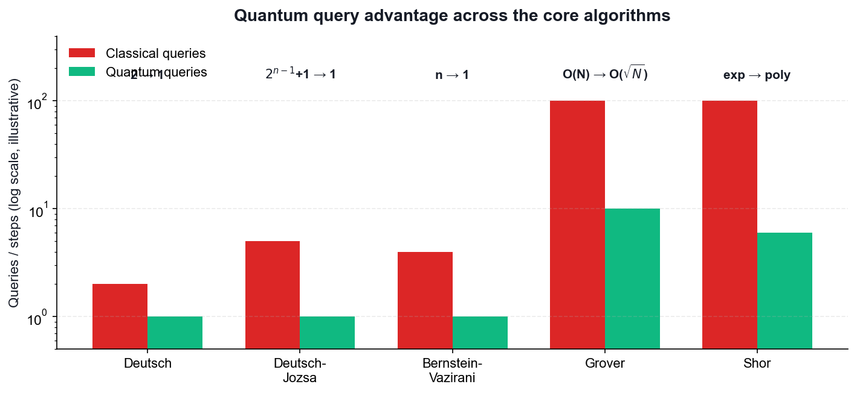
WHY THESE ALGORITHMS MATTER
Quantum Query Advantage
Query counts are illustrative — the point is the SCALING, not the absolute numbers.
Securing the Future with Quantum Computing and Cryptography · TGS-2024043419
© 2026 Tertiary Infotech Academy Pte Ltd
132

Slide 134
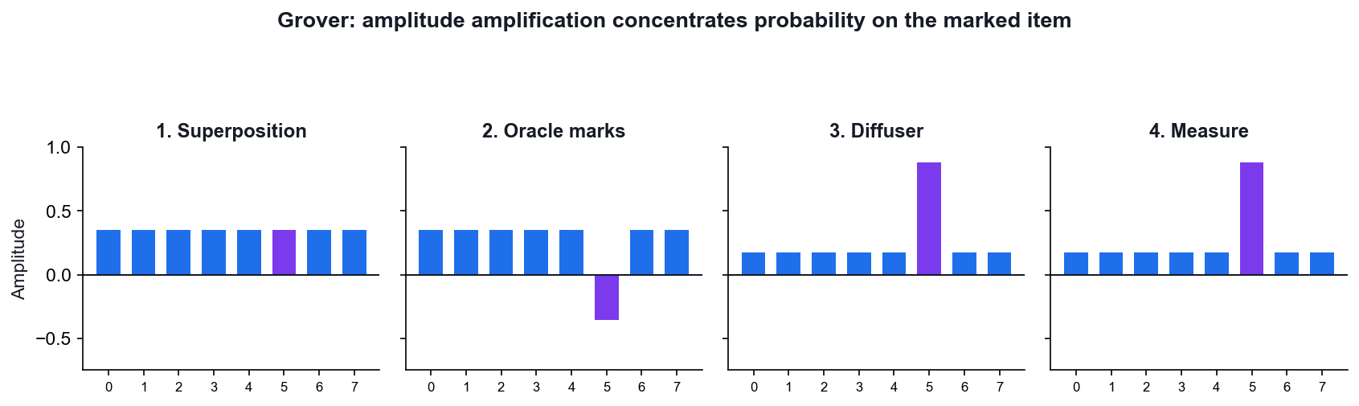
HOW GROVER ACTUALLY WORKS
Grover — Amplitude Amplification
Start
All N states share an equal amplitude of 1/√N.
Oracle
Flips the SIGN of the marked state — invisible to measurement so far.
Diffuser
Reflects every amplitude about the mean, growing the marked one.
Repeat
About (π/4)√N times — then measure.
Securing the Future with Quantum Computing and Cryptography · TGS-2024043419
© 2026 Tertiary Infotech Academy Pte Ltd
133

Slide 135
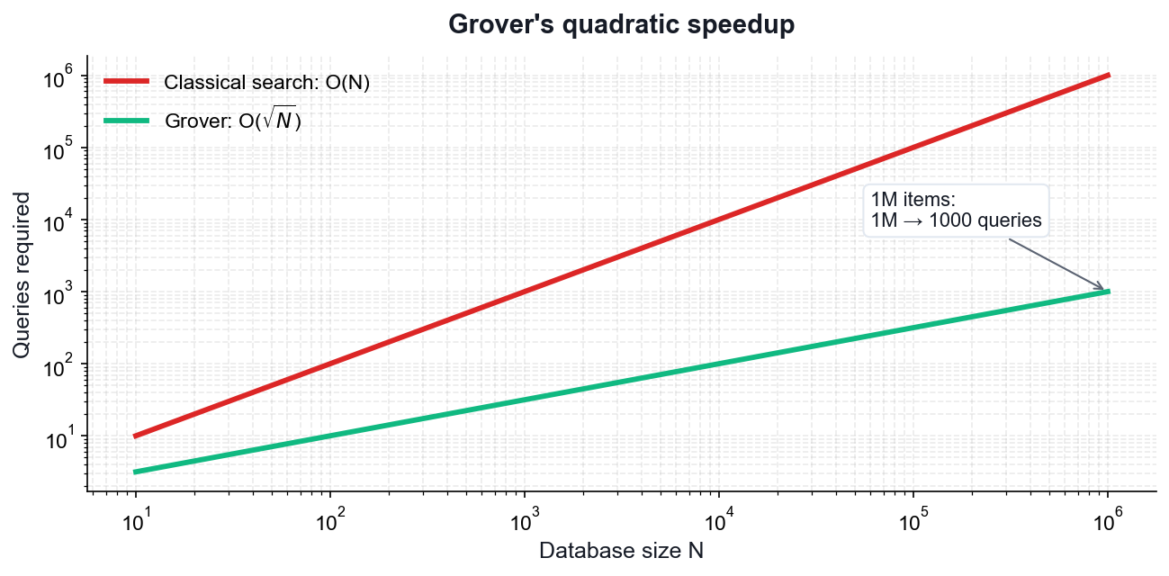
THE SCALING
Grover's Quadratic Speedup
Classical
Checking an unstructured list takes O(N) queries.
Grover
Finds the marked item in O(√N) queries.
1M items
1,000,000 checks become roughly 1,000.
Not exponential
A real speedup, but far smaller than Shor's.
Securing the Future with Quantum Computing and Cryptography · TGS-2024043419
© 2026 Tertiary Infotech Academy Pte Ltd
134

Slide 136
THE ALGORITHM BEHIND SHOR
The problem
GIVEN: a unitary U and one of its eigenvectors |u>, with
U|u> = e^(2πiφ) |u>
FIND: the phase φ ∈ [0,1), to n bits of precision.
Recall: unitary eigenvalues always have magnitude 1 (Axiom 2), so all
the information is in the single real number φ.
KEY POINT: QPE is the workhorse subroutine: order finding, factoring, quantum chemistry energies and HHL all reduce to it.
Securing the Future with Quantum Computing and Cryptography · TGS-2024043419
© 2026 Tertiary Infotech Academy Pte Ltd
135

Slide 137
THE ALGORITHM BEHIND SHOR
Step 1 — Superpose the counting register
Use two registers:
counting register: t qubits, initialised |0>ᵗ
eigenstate register: holds |u>
Apply H to every counting qubit:
(1/√2ᵗ) Σ_(k=0..2ᵗ-1) |k> (x) |u>
KEY POINT: t controls the precision: t bits give φ to t binary places.
Securing the Future with Quantum Computing and Cryptography · TGS-2024043419
© 2026 Tertiary Infotech Academy Pte Ltd
136

Slide 138
THE ALGORITHM BEHIND SHOR
Step 2 — Controlled powers of U (kickback)
Apply controlled-U^(2^j) from counting qubit j onto the eigenstate register.
By PHASE KICKBACK, since |u> is an eigenvector:
C-U^(2^j) |1>|u> = e^(2πi 2^j φ) |1>|u>
Result over the whole register:
(1/√2ᵗ) Σ_k e^(2πi k φ) |k> (x) |u>
KEY POINT: The eigenstate register is UNCHANGED throughout — every bit of the phase has been written onto the counting register. This is phase kickback at scale.
Securing the Future with Quantum Computing and Cryptography · TGS-2024043419
© 2026 Tertiary Infotech Academy Pte Ltd
137

Slide 139
THE ALGORITHM BEHIND SHOR
Step 3 — Inverse QFT extracts the phase
The counting register now holds Σ_k e^(2πi kφ)|k> — exactly the Fourier
transform of a peak at φ.
Apply the INVERSE QFT:
QFT⁻¹ ( Σ_k e^(2πi kφ)|k> ) -> |2ᵗ φ>
Measure the counting register: the result read as a binary fraction is φ.
KEY POINT: If φ has an exact t-bit expansion the answer is exact; otherwise you get the best t-bit approximation with probability ≥ 4/π² ≈ 40%.
Securing the Future with Quantum Computing and Cryptography · TGS-2024043419
© 2026 Tertiary Infotech Academy Pte Ltd
138

Slide 140
THE ALGORITHM BEHIND SHOR
Step 4 — Precision and cost
To get φ to n bits with success probability 1-ε:
t = n + ⌈log₂(2 + 1/(2ε))⌉ qubits
Cost is dominated by the controlled-U^(2^j) operations.
Worked example — U = Z, |u> = |1>: Z|1> = -|1> = e^(2πi·0.5)|1>
so φ = 0.5, and QPE returns binary 0.1 = 0.5. Verifiable by hand.
KEY POINT: The Z example is the standard classroom check — small enough to trace through by hand, and it exercises the whole pipeline.
Securing the Future with Quantum Computing and Cryptography · TGS-2024043419
© 2026 Tertiary Infotech Academy Pte Ltd
139

Slide 141
THE ALGORITHM BEHIND SHOR
Where QPE is used
ORDER FINDING / SHOR — U: |y> -> |ay mod N>. The phase encodes the
period r, so factoring reduces to QPE.
QUANTUM CHEMISTRY — U = e^(-iHt). The phase gives the ENERGY eigenvalue,
the fault-tolerant successor to VQE.
HHL (linear systems) — QPE finds the eigenvalues of the matrix A so they
can be inverted.
QUANTUM COUNTING — QPE applied to the Grover operator counts solutions.
KEY POINT: If you understand phase kickback and the QFT, you understand the engine inside most of the exponentially-fast quantum algorithms.
Securing the Future with Quantum Computing and Cryptography · TGS-2024043419
© 2026 Tertiary Infotech Academy Pte Ltd
140

Slide 142
FROM DFT TO QFT
From the classical DFT
The classical Discrete Fourier Transform maps a vector to its spectrum:
y_k = (1/√N) Σ_(j=0..N-1) x_j · e^(2πi jk/N)
The QFT is the SAME transform, applied to quantum AMPLITUDES:
QFT |j> = (1/√N) Σ_(k=0..N-1) e^(2πi jk/N) |k>
and by linearity it acts on a whole superposition at once.
KEY POINT: Same mathematics, different substrate: the DFT transforms data in memory, the QFT transforms amplitudes inside a superposition.
Securing the Future with Quantum Computing and Cryptography · TGS-2024043419
© 2026 Tertiary Infotech Academy Pte Ltd
141

Slide 143
FROM DFT TO QFT
Worked example — QFT on one qubit
For n = 1, N = 2, and e^(2πi/2) = e^(iπ) = -1:
QFT|0> = (|0> + |1>)/√2 = |+>
QFT|1> = (|0> - |1>)/√2 = |->
That is exactly the HADAMARD gate.
QFT₁ = H
KEY POINT: The Hadamard is the single-qubit QFT — a useful anchor for intuition.
Securing the Future with Quantum Computing and Cryptography · TGS-2024043419
© 2026 Tertiary Infotech Academy Pte Ltd
142

Slide 144
FROM DFT TO QFT
The circuit for n qubits
For each qubit, in order:
1. apply H
2. apply controlled-phase rotations R_k from each lower qubit,
where R_k adds the phase 2π/2^k
Finally, SWAP to reverse the qubit order.
3-qubit QFT:
H(q2) · CP(π/2: q1->q2) · CP(π/4: q0->q2)
H(q1) · CP(π/2: q0->q1)
H(q0) · SWAP(q0,q2)
KEY POINT: Each controlled rotation adds one further binary digit of phase precision.
Securing the Future with Quantum Computing and Cryptography · TGS-2024043419
© 2026 Tertiary Infotech Academy Pte Ltd
143

Slide 145
FROM DFT TO QFT
Cost and the honest caveat
QFT gate count: O(n²) on N = 2ⁿ amplitudes
Classical FFT: O(N log N) = O(n·2ⁿ)
Exponentially fewer operations — BUT:
You cannot READ OUT the transformed amplitudes. Measuring gives ONE
sample, not the spectrum. So the QFT does not accelerate signal
processing; it accelerates finding a PERIOD or a PHASE.
KEY POINT: State this caveat explicitly in class — it is the most commonly over-claimed result in quantum computing.
Securing the Future with Quantum Computing and Cryptography · TGS-2024043419
© 2026 Tertiary Infotech Academy Pte Ltd
144

Slide 146
DERIVATION
Proof — The Deutsch Algorithm
CLAIM
One oracle query decides whether f:{0,1} -> {0,1} is CONSTANT or BALANCED. Any classical algorithm needs two.
GIVEN
f is a black box with f(0), f(1) in {0,1}.
CONSTANT means f(0) = f(1); BALANCED means f(0) ≠ f(1).
The oracle is reversible: U_f |x>|y> = |x>|y ⊕ f(x)>.
Classically you must learn BOTH f(0) and f(1) — two queries — to compare them.
Securing the Future with Quantum Computing and Cryptography · TGS-2024043419
© 2026 Tertiary Infotech Academy Pte Ltd
145

Slide 147
THE DEUTSCH ALGORITHM · STEP 1 OF 6
Step 1 — Prepare the registers
Start: |0> |1>
Apply H to both qubits:
H|0> = |+> = (|0> + |1>)/√2
H|1> = |-> = (|0> - |1>)/√2
State |ψ₁> = |+> |->
= (1/√2)( |0> + |1> ) (x) |->
WHY THIS STEP: The target is deliberately put in |-> so phase kickback will fire.
Securing the Future with Quantum Computing and Cryptography · TGS-2024043419
© 2026 Tertiary Infotech Academy Pte Ltd
146

Slide 148
THE DEUTSCH ALGORITHM · STEP 2 OF 6
Step 2 — Apply the oracle (phase kickback)
By the kickback identity: U_f |x>|-> = (-1)^f(x) |x>|->
Apply it to each term of the superposition:
|ψ₂> = (1/√2)( (-1)^f(0)|0> + (-1)^f(1)|1> ) (x) |->
WHY THIS STEP: One query — but the oracle has acted on BOTH inputs at once. The target |-> is unchanged and now factors out entirely.
Securing the Future with Quantum Computing and Cryptography · TGS-2024043419
© 2026 Tertiary Infotech Academy Pte Ltd
147

Slide 149
THE DEUTSCH ALGORITHM · STEP 3 OF 6
Step 3 — Factor out the global phase
Pull (-1)^f(0) out of the bracket:
|ψ₂> = (-1)^f(0) · (1/√2)( |0> + (-1)^(f(0) ⊕ f(1)) |1> ) (x) |->
(-1)^f(0) is a GLOBAL phase — unobservable, so we may drop it.
WHY THIS STEP: Everything now depends on the single bit f(0) ⊕ f(1) — exactly the question we are asking.
Securing the Future with Quantum Computing and Cryptography · TGS-2024043419
© 2026 Tertiary Infotech Academy Pte Ltd
148

Slide 150
THE DEUTSCH ALGORITHM · STEP 4 OF 6
Step 4 — Split into the two cases
CASE A — f is CONSTANT: f(0) = f(1) => f(0) ⊕ f(1) = 0
control = (|0> + |1>)/√2 = |+>
CASE B — f is BALANCED: f(0) ≠ f(1) => f(0) ⊕ f(1) = 1
control = (|0> - |1>)/√2 = |->
WHY THIS STEP: The two cases are ORTHOGONAL states: <+|-> = 0. Orthogonal states can be distinguished perfectly by a single measurement.
Securing the Future with Quantum Computing and Cryptography · TGS-2024043419
© 2026 Tertiary Infotech Academy Pte Ltd
149

Slide 151
THE DEUTSCH ALGORITHM · STEP 5 OF 6
Step 5 — Interfere with a final Hadamard
H is its own inverse and maps the |+>/|-> basis to the |0>/|1> basis:
H|+> = |0>
H|-> = |1>
CASE A (constant): H|+> = |0> -> measure 0 with probability 1
CASE B (balanced): H|-> = |1> -> measure 1 with probability 1
WHY THIS STEP: This is the interference step: a phase difference becomes an amplitude difference.
Securing the Future with Quantum Computing and Cryptography · TGS-2024043419
© 2026 Tertiary Infotech Academy Pte Ltd
150

Slide 152
THE DEUTSCH ALGORITHM · STEP 6 OF 6
Step 6 — Conclusion
Measure the control qubit:
result 0 => f is CONSTANT
result 1 => f is BALANCED
Total oracle queries used: ONE.
Classical worst case: TWO.
WHY THIS STEP: The answer is deterministic — not probabilistic. No repetition is needed.
Securing the Future with Quantum Computing and Cryptography · TGS-2024043419
© 2026 Tertiary Infotech Academy Pte Ltd
151

Slide 153
QED
The Deutsch Algorithm — Result
RESULT
Measuring 0 proves f is constant; measuring 1 proves f is balanced — with certainty, after a single oracle query.
WHY IT MATTERS
Deutsch was the first proof that a quantum computer can beat every classical algorithm at a well-defined task. It answers a GLOBAL question (is f constant?) without learning the LOCAL values f(0) and f(1) — the template every later algorithm follows.
Securing the Future with Quantum Computing and Cryptography · TGS-2024043419
© 2026 Tertiary Infotech Academy Pte Ltd
152

Slide 154
DERIVATION
Proof — Deutsch-Jozsa (n qubits)
CLAIM
For f:{0,1}ⁿ -> {0,1} PROMISED to be constant or balanced, one query decides which. Classically the worst case is 2^(n-1) + 1 queries.
GIVEN
Promise: f is either constant (same output for all 2ⁿ inputs) or balanced (exactly half the inputs give 0).
Register: n input qubits in |0>ⁿ, plus one target qubit in |1>.
Securing the Future with Quantum Computing and Cryptography · TGS-2024043419
© 2026 Tertiary Infotech Academy Pte Ltd
153

Slide 155
DEUTSCH-JOZSA (N QUBITS) · STEP 1 OF 5
Step 1 — Superposition over ALL 2ⁿ inputs
Apply H to each of the n input qubits:
Hⁿ |0>ⁿ = (1/√2ⁿ) Σ_x |x> (sum over all x in {0,1}ⁿ)
Target: H|1> = |->
State: (1/√2ⁿ) Σ_x |x> (x) |->
WHY THIS STEP: A single register now holds all 2ⁿ input strings simultaneously.
Securing the Future with Quantum Computing and Cryptography · TGS-2024043419
© 2026 Tertiary Infotech Academy Pte Ltd
154

Slide 156
DEUTSCH-JOZSA (N QUBITS) · STEP 2 OF 5
Step 2 — Oracle applies the sign
U_f |x>|-> = (-1)^f(x) |x>|->
State: (1/√2ⁿ) Σ_x (-1)^f(x) |x> (x) |->
WHY THIS STEP: ONE query has tagged every one of the 2ⁿ inputs with the sign of f(x).
Securing the Future with Quantum Computing and Cryptography · TGS-2024043419
© 2026 Tertiary Infotech Academy Pte Ltd
155

Slide 157
DEUTSCH-JOZSA (N QUBITS) · STEP 3 OF 5
Step 3 — Final Hadamard layer
The n-qubit Hadamard acts as:
Hⁿ |x> = (1/√2ⁿ) Σ_z (-1)^(x·z) |z> where x·z = Σ xᵢzᵢ mod 2
Applying it:
(1/2ⁿ) Σ_z [ Σ_x (-1)^(f(x) + x·z) ] |z>
WHY THIS STEP: The bracket is the amplitude of outcome |z> — a sum of ±1 terms.
Securing the Future with Quantum Computing and Cryptography · TGS-2024043419
© 2026 Tertiary Infotech Academy Pte Ltd
156

Slide 158
DEUTSCH-JOZSA (N QUBITS) · STEP 4 OF 5
Step 4 — Amplitude of the all-zeros outcome
Set z = 0…0. Then x·z = 0 for every x, so:
amplitude(|0…0>) = (1/2ⁿ) Σ_x (-1)^f(x)
CONSTANT: every term is the same sign, so the sum is ±2ⁿ
amplitude = ±1 -> probability |±1|² = 1
BALANCED: half the terms are +1 and half are -1, so the sum is 0
amplitude = 0 -> probability 0
WHY THIS STEP: Perfect constructive interference in one case, perfect destructive in the other.
Securing the Future with Quantum Computing and Cryptography · TGS-2024043419
© 2026 Tertiary Infotech Academy Pte Ltd
157

Slide 159
DEUTSCH-JOZSA (N QUBITS) · STEP 5 OF 5
Step 5 — Conclusion
Measure the n input qubits:
all zeros (000…0) => f is CONSTANT (certainty)
anything else => f is BALANCED (certainty)
Quantum: 1 query. Classical worst case: 2^(n-1) + 1 queries.
WHY THIS STEP: For n = 20 that is 1 query versus 524,289 — an exponential separation.
Securing the Future with Quantum Computing and Cryptography · TGS-2024043419
© 2026 Tertiary Infotech Academy Pte Ltd
158

Slide 160
QED
Deutsch-Jozsa (n qubits) — Result
RESULT
An all-zeros measurement proves f is constant; any other outcome proves f is balanced. One query, with certainty.
WHY IT MATTERS
Deutsch-Jozsa gives the first EXPONENTIAL separation between quantum and classical query complexity. The pattern — superpose, kick back the phase, interfere — is the skeleton of Bernstein-Vazirani, Simon and ultimately Shor.
Securing the Future with Quantum Computing and Cryptography · TGS-2024043419
© 2026 Tertiary Infotech Academy Pte Ltd
159

Slide 161
DERIVATION
Proof — Grover's Algorithm and the √N Speedup
CLAIM
Grover finds a marked item among N in O(√N) queries, and (π/4)√N iterations is optimal.
GIVEN
Search space of N = 2ⁿ items with exactly one marked item |w>.
Oracle: O|x> = -|x> if x = w, else O|x> = |x> (a phase oracle).
Classical search needs O(N) queries — on average N/2.
Securing the Future with Quantum Computing and Cryptography · TGS-2024043419
© 2026 Tertiary Infotech Academy Pte Ltd
160

Slide 162
GROVER'S ALGORITHM AND THE √N SPEEDUP · STEP 1 OF 7
Step 1 — Uniform superposition
|s> = Hⁿ|0>ⁿ = (1/√N) Σ_x |x>
Overlap with the marked item: <w|s> = 1/√N
So P(measuring w now) = 1/N — no better than a random guess.
WHY THIS STEP: Superposition alone gives NO advantage. Interference must do the work.
Securing the Future with Quantum Computing and Cryptography · TGS-2024043419
© 2026 Tertiary Infotech Academy Pte Ltd
161

Slide 163
GROVER'S ALGORITHM AND THE √N SPEEDUP · STEP 2 OF 7
Step 2 — Work in a 2-D plane
Define the state orthogonal to the marked item:
|s'> = (1/√(N-1)) Σ_(x≠w) |x>
Then |s> = sin(θ)|w> + cos(θ)|s'> where sin(θ) = 1/√N.
Everything that follows stays in the 2-D plane spanned by |w> and |s'>.
WHY THIS STEP: Reducing a 2ⁿ-dimensional problem to a 2-D rotation is the key simplification.
Securing the Future with Quantum Computing and Cryptography · TGS-2024043419
© 2026 Tertiary Infotech Academy Pte Ltd
162

Slide 164
GROVER'S ALGORITHM AND THE √N SPEEDUP · STEP 3 OF 7
Step 3 — The oracle is a reflection
O flips the sign of the |w> component only:
O( sin θ|w> + cos θ|s'> ) = -sin θ|w> + cos θ|s'>
Geometrically: a REFLECTION about the |s'> axis.
WHY THIS STEP: The marked item is now 'marked' by a phase — still invisible to measurement.
Securing the Future with Quantum Computing and Cryptography · TGS-2024043419
© 2026 Tertiary Infotech Academy Pte Ltd
163

Slide 165
GROVER'S ALGORITHM AND THE √N SPEEDUP · STEP 4 OF 7
Step 4 — The diffuser is a second reflection
D = 2|s><s| - I
This reflects any state about |s>. Equivalently: 'invert about the mean'.
Circuit: Hⁿ · (2|0><0| - I) · Hⁿ
WHY THIS STEP: Two reflections in a plane compose to a ROTATION — that is the whole trick.
Securing the Future with Quantum Computing and Cryptography · TGS-2024043419
© 2026 Tertiary Infotech Academy Pte Ltd
164

Slide 166
GROVER'S ALGORITHM AND THE √N SPEEDUP · STEP 5 OF 7
Step 5 — Each Grover iteration rotates by 2θ
Composing the two reflections:
G = D·O rotates the state by angle 2θ toward |w>.
After k iterations:
|ψ_k> = sin((2k+1)θ)|w> + cos((2k+1)θ)|s'>
So P(measure w) = sin²((2k+1)θ).
WHY THIS STEP: The amplitude on |w> grows roughly LINEARLY in k — while probability grows quadratically.
Securing the Future with Quantum Computing and Cryptography · TGS-2024043419
© 2026 Tertiary Infotech Academy Pte Ltd
165

Slide 167
GROVER'S ALGORITHM AND THE √N SPEEDUP · STEP 6 OF 7
Step 6 — Optimal number of iterations
Maximise by setting (2k+1)θ = π/2:
k = π/(4θ) - 1/2
For large N, sin θ = 1/√N gives θ ≈ 1/√N, so:
k ≈ (π/4)√N
Example N = 10⁶: k ≈ 785 queries versus ~500,000 classically.
WHY THIS STEP: OVER-ROTATION IS REAL: run too many iterations and the state rotates PAST |w>, and the success probability falls again.
Securing the Future with Quantum Computing and Cryptography · TGS-2024043419
© 2026 Tertiary Infotech Academy Pte Ltd
166

Slide 168
GROVER'S ALGORITHM AND THE √N SPEEDUP · STEP 7 OF 7
Step 7 — Optimality
Bennett, Bernstein, Brassard and Vazirani (1997) proved that ANY quantum
algorithm needs Ω(√N) queries for unstructured search.
Grover therefore achieves the optimal scaling — it cannot be improved.
WHY THIS STEP: The speedup is QUADRATIC, not exponential. This is why Grover only halves effective symmetric key lengths rather than breaking them.
Securing the Future with Quantum Computing and Cryptography · TGS-2024043419
© 2026 Tertiary Infotech Academy Pte Ltd
167

Slide 169
QED
Grover's Algorithm and the √N Speedup — Result
RESULT
After ≈(π/4)√N iterations the marked state is measured with probability ≈1. The quadratic speedup is provably optimal for unstructured search.
WHY IT MATTERS
Grover is the reason AES-128 drops to ~64-bit effective security against a quantum adversary and why NIST recommends AES-256. Its amplitude-amplification core also underpins quantum counting and amplitude estimation.
Securing the Future with Quantum Computing and Cryptography · TGS-2024043419
© 2026 Tertiary Infotech Academy Pte Ltd
168

Slide 170
DERIVATION
Proof — The Quantum Fourier Transform is Efficient
CLAIM
The QFT on n qubits needs only O(n²) gates, versus O(N log N) = O(n·2ⁿ) for the classical FFT.
GIVEN
N = 2ⁿ. The QFT acts as |j> -> (1/√N) Σ_k e^(2πi jk/N) |k>.
ω = e^(2πi/N) is the primitive N-th root of unity.
Securing the Future with Quantum Computing and Cryptography · TGS-2024043419
© 2026 Tertiary Infotech Academy Pte Ltd
169

Slide 171
THE QUANTUM FOURIER TRANSFORM IS EFFICIENT · STEP 1 OF 4
Step 1 — The product-form identity
Write k in binary and expand the exponent. The 2ⁿ-term sum FACTORISES:
QFT|j> = (1/√N) ⊗_(l=1..n) ( |0> + e^(2πi j/2^l) |1> )
The n-qubit output is a PRODUCT of n single-qubit states.
WHY THIS STEP: This factorisation is why the QFT is efficient — an exponentially large sum collapses into n independent factors.
Securing the Future with Quantum Computing and Cryptography · TGS-2024043419
© 2026 Tertiary Infotech Academy Pte Ltd
170

Slide 172
THE QUANTUM FOURIER TRANSFORM IS EFFICIENT · STEP 2 OF 4
Step 2 — Build each factor: H + CPhase
Qubit l needs the phase e^(2πi j/2^l), assembled from:
H — creates (|0> + e^(2πi 0.j_l) |1>)/√2
CROT_k — adds the phase 2π/2^k, controlled on a lower qubit
Qubit 1 needs 1 H + (n-1) controlled rotations
Qubit 2 needs 1 H + (n-2) controlled rotations …
WHY THIS STEP: Each controlled rotation contributes one more bit of phase precision.
Securing the Future with Quantum Computing and Cryptography · TGS-2024043419
© 2026 Tertiary Infotech Academy Pte Ltd
171

Slide 173
THE QUANTUM FOURIER TRANSFORM IS EFFICIENT · STEP 3 OF 4
Step 3 — Count the gates
Total = n Hadamards + Σ(n-1) + (n-2) + … + 1 controlled rotations
= n + n(n-1)/2
= O(n²)
Plus n/2 SWAPs to reverse the qubit order.
For n = 10: ~55 gates. Classical FFT on N = 1024: ~10,240 operations.
WHY THIS STEP: Quadratic in the number of QUBITS, versus linearithmic in the number of AMPLITUDES — an exponential saving.
Securing the Future with Quantum Computing and Cryptography · TGS-2024043419
© 2026 Tertiary Infotech Academy Pte Ltd
172

Slide 174
THE QUANTUM FOURIER TRANSFORM IS EFFICIENT · STEP 4 OF 4
Step 4 — The essential caveat
The QFT transforms AMPLITUDES, which cannot be read out directly.
Measuring gives ONE sample from the transformed distribution, not the
whole spectrum.
So the QFT is NOT a drop-in replacement for the FFT in signal processing.
Its power is in extracting a PERIOD or a PHASE — which is exactly what
Shor's algorithm and quantum phase estimation need.
WHY THIS STEP: An honest statement of what the speedup does and does not buy — a common source of hype.
Securing the Future with Quantum Computing and Cryptography · TGS-2024043419
© 2026 Tertiary Infotech Academy Pte Ltd
173

Slide 175
QED
The Quantum Fourier Transform is Efficient — Result
RESULT
The QFT runs in O(n²) gates thanks to the product-form factorisation, providing the exponential engine inside phase estimation and Shor's algorithm.
WHY IT MATTERS
The QFT is the single most important subroutine in quantum computing — it is what turns period finding, and therefore factoring, from exponential into polynomial.
Securing the Future with Quantum Computing and Cryptography · TGS-2024043419
© 2026 Tertiary Infotech Academy Pte Ltd
174

Slide 176
WHAT YOU'LL DO
Hands-On Activities — Quantum Algorithms
Activities 9–10
Activities 11–12
• Deutsch and Deutsch-Jozsa Algorithms
• Bernstein-Vazirani Algorithm
• Grover's Search Algorithm
• Quantum Fourier Transform
Securing the Future with Quantum Computing and Cryptography · TGS-2024043419
© 2026 Tertiary Infotech Academy Pte Ltd
175

Slide 177
TOPIC 05 · HANDS-ON ACTIVITY
ACTIVITY 9
Deutsch and Deutsch-Jozsa Algorithms
Implement the first algorithms to show a provable quantum advantage: decide whether a black-box function is constant or balanced with a single query, then generalise from one input bit to n.
MAPS TO LO6 — Establish guidelines for selecting quantum computing algorithms
YOU'LL PRODUCE
Deutsch and Deutsch-Jozsa circuits with all four oracle types, run on IBM Quantum hardware, correctly classifying each function in one query.
Tools: Qiskit 2.x, IBM Quantum Runtime, OpenQASM
Full step-by-step guide: Learner Guide — Activity 9: Deutsch and Deutsch-Jozsa Algorithms
Securing the Future with Quantum Computing and Cryptography · TGS-2024043419
© 2026 Tertiary Infotech Academy Pte Ltd
176

Slide 178
ACTIVITY 9 · VERIFY & DEBRIEF
Deutsch and Deutsch-Jozsa Algorithms
TEST IT — HOW YOU KNOW IT WORKED
The Deutsch circuit measures 0 for both constant oracles and 1 for both balanced oracles; Deutsch-Jozsa returns the all-zeros string for a constant function and a non-zero string for a balanced function — each using exactly one oracle query.
DISCUSS WITH YOUR TRAINER
What did the result show?
Why does it work?
Where would you use it?
Restate the outcome in your own words.
Name the quantum principle the activity relies on.
Give one realistic application in your own field.
Securing the Future with Quantum Computing and Cryptography · TGS-2024043419
© 2026 Tertiary Infotech Academy Pte Ltd
177

Slide 179
TOPIC 05 · HANDS-ON ACTIVITY
ACTIVITY 10
Bernstein-Vazirani Algorithm
Recover an n-bit hidden string in a single oracle query. Classically you would need n queries — one per bit — making this a clean demonstration of linear-to-constant query speedup.
MAPS TO LO6 — Establish guidelines for selecting quantum computing algorithms
YOU'LL PRODUCE
A Bernstein-Vazirani circuit that recovers a chosen hidden string such as 1011 in one query on real hardware.
Tools: Qiskit 2.x, IBM Quantum Runtime
Full step-by-step guide: Learner Guide — Activity 10: Bernstein-Vazirani Algorithm
Securing the Future with Quantum Computing and Cryptography · TGS-2024043419
© 2026 Tertiary Infotech Academy Pte Ltd
178

Slide 180
ACTIVITY 10 · VERIFY & DEBRIEF
Bernstein-Vazirani Algorithm
TEST IT — HOW YOU KNOW IT WORKED
The most frequent measured bit string equals the hidden string s that was encoded in the oracle, recovered with a single oracle query regardless of the length of s.
DISCUSS WITH YOUR TRAINER
What did the result show?
Why does it work?
Where would you use it?
Restate the outcome in your own words.
Name the quantum principle the activity relies on.
Give one realistic application in your own field.
Securing the Future with Quantum Computing and Cryptography · TGS-2024043419
© 2026 Tertiary Infotech Academy Pte Ltd
179

Slide 181
TOPIC 05 · HANDS-ON ACTIVITY
ACTIVITY 11
Grover's Search Algorithm
Implement amplitude amplification to find a marked item in an unstructured search space, using the phase oracle and the diffuser, and see the quadratic O(sqrt(N)) speedup for 2-qubit and 3-qubit searches.
MAPS TO LO6, LO7 — Select algorithms and synthesize quantum methodologies
YOU'LL PRODUCE
Grover circuits for 2 and 3 qubits that amplify the marked state to a high measurement probability on real hardware.
Tools: Qiskit 2.x, IBM Quantum Runtime, OpenQASM
Full step-by-step guide: Learner Guide — Activity 11: Grover's Search Algorithm
Securing the Future with Quantum Computing and Cryptography · TGS-2024043419
© 2026 Tertiary Infotech Academy Pte Ltd
180

Slide 182
ACTIVITY 11 · VERIFY & DEBRIEF
Grover's Search Algorithm
TEST IT — HOW YOU KNOW IT WORKED
For 2 qubits the marked state is measured with near-certainty after one Grover iteration; for 3 qubits it dominates the histogram after two iterations; applying too many iterations visibly reduces the success probability.
DISCUSS WITH YOUR TRAINER
What did the result show?
Why does it work?
Where would you use it?
Restate the outcome in your own words.
Name the quantum principle the activity relies on.
Give one realistic application in your own field.
Securing the Future with Quantum Computing and Cryptography · TGS-2024043419
© 2026 Tertiary Infotech Academy Pte Ltd
181

Slide 183
TOPIC 05 · HANDS-ON ACTIVITY
ACTIVITY 12
Quantum Fourier Transform
Build the QFT circuit from Hadamard and controlled-phase gates, verify it against the classical DFT, and understand why it is the engine behind phase estimation and Shor's algorithm.
MAPS TO LO6, LO7 — Establish guidelines for selecting quantum computing algorithms
YOU'LL PRODUCE
QFT circuits for 3, 4 and 5 qubits, validated against a classical DFT reference and run on IBM Quantum hardware.
Tools: Qiskit 2.x, NumPy, IBM Quantum Runtime, OpenQASM
Full step-by-step guide: Learner Guide — Activity 12: Quantum Fourier Transform
Securing the Future with Quantum Computing and Cryptography · TGS-2024043419
© 2026 Tertiary Infotech Academy Pte Ltd
182

Slide 184
ACTIVITY 12 · VERIFY & DEBRIEF
Quantum Fourier Transform
TEST IT — HOW YOU KNOW IT WORKED
Your hand-built QFT circuit produces the same state vector as Qiskit's built-in QFT and matches a normalised classical FFT of the same input, using on the order of n^2 gates.
DISCUSS WITH YOUR TRAINER
What did the result show?
Why does it work?
Where would you use it?
Restate the outcome in your own words.
Name the quantum principle the activity relies on.
Give one realistic application in your own field.
Securing the Future with Quantum Computing and Cryptography · TGS-2024043419
© 2026 Tertiary Infotech Academy Pte Ltd
183

Slide 185
TOPIC RECAP
Recap — Quantum Algorithms
• The query (oracle) model
• Deutsch algorithm
• Deutsch-Jozsa
• Bernstein-Vazirani
• Grover search
• Quantum Fourier Transform
Securing the Future with Quantum Computing and Cryptography · TGS-2024043419
© 2026 Tertiary Infotech Academy Pte Ltd
184

Slide 186
06
TOPIC 06
Quantum Cryptography and Quantum Safety
Classical Cryptography · The Quantum Threat · Shor Algorithm · Post-Quantum Cryptography
Securing the Future with Quantum Computing and Cryptography · TGS-2024043419
© 2026 Tertiary Infotech Academy Pte Ltd
185

Slide 187
MAPS TO LO4, LO7
Key Concepts — Quantum Cryptography and Quantum Safety
Goals of cryptography
Confidentiality, integrity, authentication and non-repudiation are the four properties every scheme must address.
Classical schemes
Symmetric (AES), asymmetric (RSA, ECC) and hash functions (SHA-256) rest on problems that are hard for classical computers.
1
2
The quantum threat
Shor's algorithm breaks RSA and ECC in polynomial time; Grover halves the effective key length of symmetric ciphers.
Shor's algorithm
Reduces factoring to period-finding, then uses the QFT to extract the period — turning a hard problem into an easy one.
3
4
Harvest now, decrypt later
Adversaries can record encrypted traffic today and decrypt it once a cryptographically relevant quantum computer exists.
Post-quantum cryptography
NIST has standardised ML-KEM (Kyber), ML-DSA (Dilithium), SLH-DSA (SPHINCS+) and HQC as quantum-resistant replacements.
5
6
Securing the Future with Quantum Computing and Cryptography · TGS-2024043419
© 2026 Tertiary Infotech Academy Pte Ltd
186

Slide 188
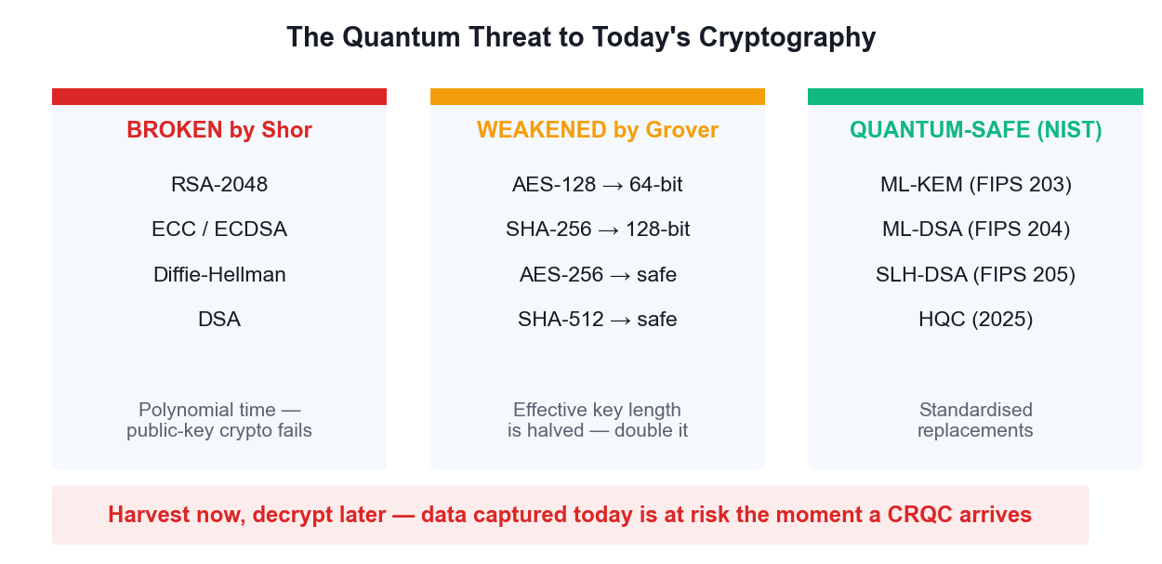
WHAT BREAKS AND WHAT SURVIVES
The Quantum Threat to Cryptography
Symmetric crypto survives by doubling key length; public-key crypto must be replaced outright.
Securing the Future with Quantum Computing and Cryptography · TGS-2024043419
© 2026 Tertiary Infotech Academy Pte Ltd
187

Slide 189
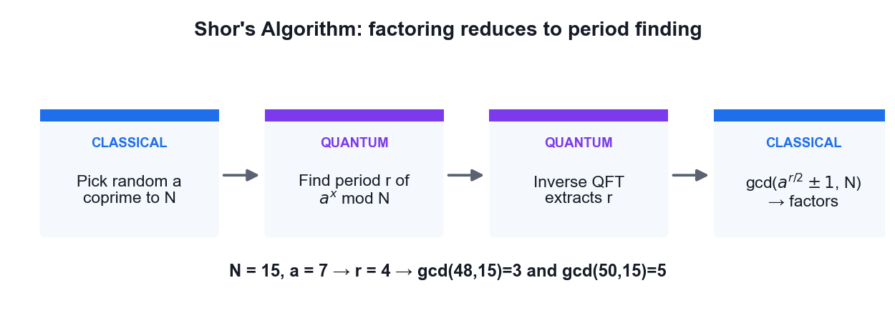
FACTORING VIA PERIOD FINDING
Shor's Algorithm
Only the period-finding step is quantum — the rest is classical number theory.
Securing the Future with Quantum Computing and Cryptography · TGS-2024043419
© 2026 Tertiary Infotech Academy Pte Ltd
188

Slide 190
THE FOUR GOALS: CONFIDENTIALITY · INTEGRITY · AUTHENTICATION · NON-REPUDIATION
Classical Cryptography — What You Must Know
Type
Example
Key
Broken by
Symmetric
AES-256
One shared secret key
Grover (halves strength)
Asymmetric
RSA-2048, ECC
Public + private key pair
Shor (fully broken)
Hash
SHA-256
No key
Grover (halves strength)
PQC KEM
ML-KEM (Kyber)
Lattice-based
Not known to be broken
PQC signature
ML-DSA, SLH-DSA
Lattice / hash-based
Not known to be broken
Securing the Future with Quantum Computing and Cryptography · TGS-2024043419
© 2026 Tertiary Infotech Academy Pte Ltd
189

Slide 191
WHY MIGRATE BEFORE THE THREAT ARRIVES
Harvest now, decrypt later.
An adversary can record your encrypted traffic today and decrypt it the day a cryptographically relevant quantum computer exists. Any secret that must stay confidential for a decade is already at risk.
Securing the Future with Quantum Computing and Cryptography · TGS-2024043419
© 2026 Tertiary Infotech Academy Pte Ltd
190

Slide 192
WHAT TO DO ON MONDAY MORNING
The threat timeline
Three dates decide your risk (Mosca's theorem):
X = how long your data must stay secret (years)
Y = how long migration will take you (years)
Z = time until a cryptographically relevant QC (years)
IF X + Y > Z then you are ALREADY exposed.
Health records X=25y, migration Y=5y, Z estimated 10-15y -> act now.
KEY POINT: Mosca's inequality turns a vague fear into a concrete deadline you can put in front of a board.
Securing the Future with Quantum Computing and Cryptography · TGS-2024043419
© 2026 Tertiary Infotech Academy Pte Ltd
191

Slide 193
WHAT TO DO ON MONDAY MORNING
Step 1 — Build a cryptographic inventory (CBOM)
You cannot migrate what you cannot see. Enumerate:
• TLS certificates and their key algorithms
• VPNs, SSH keys, code-signing certificates
• database and backup encryption
• hardcoded crypto in applications and firmware
• third-party and SaaS dependencies
Produce a Cryptographic Bill of Materials (CBOM). Tools: CBOM/CycloneDX,
sslyze, openssl scanning, source-code scanners.
KEY POINT: Most organisations discover far more RSA and ECC than they expected, especially embedded in vendor products.
Securing the Future with Quantum Computing and Cryptography · TGS-2024043419
© 2026 Tertiary Infotech Academy Pte Ltd
192

Slide 194
WHAT TO DO ON MONDAY MORNING
Step 2 — Classify and prioritise
BROKEN by Shor RSA, ECC, ECDSA, ECDH, DH, DSA -> must replace
WEAKENED by Grover AES-128, SHA-256 -> double key size
SAFE AES-256, SHA-512, SHA-3 -> keep
Priority score = (data lifetime) × (exposure) × (replacement difficulty)
Rank highest: long-lived secrets, long-lived devices, anything whose
traffic crosses an untrusted network today.
KEY POINT: Harvest-now-decrypt-later means long confidentiality lifetimes dominate the ranking — not how sensitive the system feels today.
Securing the Future with Quantum Computing and Cryptography · TGS-2024043419
© 2026 Tertiary Infotech Academy Pte Ltd
193

Slide 195
WHAT TO DO ON MONDAY MORNING
Step 3 — Deploy the NIST standards
FIPS 203 ML-KEM (Kyber) key encapsulation — replaces RSA/ECDH
FIPS 204 ML-DSA (Dilithium) signatures — the general-purpose default
FIPS 205 SLH-DSA (SPHINCS+) hash-based signatures — conservative backup
2025 HQC code-based KEM — algorithmic diversity
Chosen for structural DIVERSITY: lattice, hash and code-based problems,
so one mathematical breakthrough cannot break everything at once.
KEY POINT: SLH-DSA has larger signatures but rests only on hash-function security — the most conservative assumption available.
Securing the Future with Quantum Computing and Cryptography · TGS-2024043419
© 2026 Tertiary Infotech Academy Pte Ltd
194

Slide 196
WHAT TO DO ON MONDAY MORNING
Step 4 — Hybrid mode during transition
Run classical AND post-quantum together, combining both shared secrets:
shared_secret = KDF( ECDH_secret || ML-KEM_secret )
The session stays secure if EITHER component holds.
Already deployed: X25519+ML-KEM768 in Chrome, Firefox, Cloudflare,
Signal (PQXDH), Apple iMessage (PQ3), OpenSSH 9.x.
KEY POINT: Hybrid protects against both a future quantum attack AND an implementation flaw in the new, less battle-tested PQC code.
Securing the Future with Quantum Computing and Cryptography · TGS-2024043419
© 2026 Tertiary Infotech Academy Pte Ltd
195

Slide 197
WHAT TO DO ON MONDAY MORNING
Step 5 — Build crypto-agility
The real lesson of this migration is that there will be ANOTHER one.
• never hardcode algorithms — make them configuration
• negotiate algorithms at the protocol level
• centralise crypto in a library or service, not scattered in apps
• keep certificate lifetimes short so rotation is routine
• test algorithm swaps in CI
Design goal: changing algorithm should be a CONFIG change, not a rewrite.
KEY POINT: Organisations that built crypto-agility for the SHA-1 to SHA-2 migration are finding the PQC transition dramatically cheaper.
Securing the Future with Quantum Computing and Cryptography · TGS-2024043419
© 2026 Tertiary Infotech Academy Pte Ltd
196

Slide 198
THREATS, DEFENCES AND WHAT ACTUALLY WORKS
Two meanings of 'quantum security'
1. SECURITY AGAINST quantum computers
= Post-Quantum Cryptography (PQC)
Classical maths, classical hardware, believed quantum-resistant.
Runs on the machines you already own.
2. SECURITY USING quantum physics
= QKD, QRNG, device-independent cryptography
Needs quantum hardware; security from physical law.
KEY POINT: These are constantly conflated in vendor marketing. Know which one is being sold to you.
Securing the Future with Quantum Computing and Cryptography · TGS-2024043419
© 2026 Tertiary Infotech Academy Pte Ltd
197

Slide 199
THREATS, DEFENCES AND WHAT ACTUALLY WORKS
The quantum threat model
SHOR breaks RSA, DH, ECC, ECDSA outright — polynomial time.
All public-key crypto in use today fails.
GROVER halves effective symmetric key length.
AES-128 -> ~64-bit security; AES-256 stays safe.
(In practice the parallelisation penalty makes this weaker still.)
HARVEST NOW, DECRYPT LATER
The attack is happening TODAY. Encrypted traffic is being
recorded now for decryption once a CRQC exists.
KEY POINT: Note the asymmetry: symmetric crypto survives with bigger keys; public-key crypto must be replaced entirely.
Securing the Future with Quantum Computing and Cryptography · TGS-2024043419
© 2026 Tertiary Infotech Academy Pte Ltd
198

Slide 200
THREATS, DEFENCES AND WHAT ACTUALLY WORKS
QKD vs PQC — an honest comparison
QKD PQC
security from physics security from hard maths
needs dedicated fibre/satellite runs on existing hardware
~100-500 km without repeaters unlimited range (internet)
expensive dedicated hardware software update
no authentication built in signatures included
point-to-point links works at internet scale
NSA/NCSC advise PQC for general use; QKD suits specific high-value links.
KEY POINT: QKD is NOT a drop-in replacement for public-key infrastructure — it still needs an authenticated classical channel to prevent man-in-the-middle.
Securing the Future with Quantum Computing and Cryptography · TGS-2024043419
© 2026 Tertiary Infotech Academy Pte Ltd
199

Slide 201
THREATS, DEFENCES AND WHAT ACTUALLY WORKS
Quantum random number generation (QRNG)
Classical PRNGs are DETERMINISTIC — given the seed, the output follows.
QRNG derives randomness from a genuinely indeterministic quantum event:
• which path a photon takes at a beamsplitter
• vacuum fluctuation amplitude
• arrival-time jitter of photons
Axiom 4 (the Born rule) guarantees the outcome is fundamentally random,
not merely hard to predict.
KEY POINT: QRNG is the most mature and deployable quantum security technology today — and weak randomness is a very common real-world failure.
Securing the Future with Quantum Computing and Cryptography · TGS-2024043419
© 2026 Tertiary Infotech Academy Pte Ltd
200

Slide 202
THREATS, DEFENCES AND WHAT ACTUALLY WORKS
Defence-in-depth for the quantum era
NOW inventory crypto; switch to AES-256 and SHA-384/512;
deploy hybrid key exchange; buy crypto-agility
NEXT migrate signatures to ML-DSA; PQC certificate chains;
update embedded and IoT firmware pipelines
ONGOING monitor NIST/vendor guidance; re-run the CBOM;
treat algorithm agility as a permanent capability
SPECIAL QKD only where the threat model and budget genuinely justify it
KEY POINT: The sequencing matters: confidentiality (harvest-now risk) before authenticity (which an attacker must break in real time).
Securing the Future with Quantum Computing and Cryptography · TGS-2024043419
© 2026 Tertiary Infotech Academy Pte Ltd
201

Slide 203
DERIVATION
Proof — Shor's Algorithm Breaks RSA
CLAIM
Factoring reduces to period finding, which a quantum computer solves in polynomial time.
GIVEN
Goal: factor a composite N (e.g. an RSA modulus).
Best known classical method (GNFS) is sub-exponential: exp(O((log N)^(1/3))).
Shor runs in O((log N)³) — polynomial.
Securing the Future with Quantum Computing and Cryptography · TGS-2024043419
© 2026 Tertiary Infotech Academy Pte Ltd
202

Slide 204
SHOR'S ALGORITHM BREAKS RSA · STEP 1 OF 6
Step 1 — Reduce factoring to order finding
Pick a random a with 1 < a < N.
If gcd(a, N) ≠ 1 we already have a factor (lucky — done).
Otherwise find the ORDER r: the smallest r > 0 with
a^r ≡ 1 (mod N)
WHY THIS STEP: This reduction is entirely CLASSICAL number theory — no quantum yet.
Securing the Future with Quantum Computing and Cryptography · TGS-2024043419
© 2026 Tertiary Infotech Academy Pte Ltd
203

Slide 205
SHOR'S ALGORITHM BREAKS RSA · STEP 2 OF 6
Step 2 — Why the order gives a factor
If r is EVEN, then a^r - 1 ≡ 0 (mod N) factors as:
(a^(r/2) - 1)(a^(r/2) + 1) ≡ 0 (mod N)
So N divides that product. Provided a^(r/2) ≢ -1 (mod N),
gcd(a^(r/2) - 1, N) and gcd(a^(r/2) + 1, N)
are NON-TRIVIAL factors of N.
P(r even AND the condition holds) ≥ 1/2 for random a — so a few tries suffice.
WHY THIS STEP: gcd is computed classically in polynomial time by Euclid's algorithm.
Securing the Future with Quantum Computing and Cryptography · TGS-2024043419
© 2026 Tertiary Infotech Academy Pte Ltd
204

Slide 206
SHOR'S ALGORITHM BREAKS RSA · STEP 3 OF 6
Step 3 — Worked example: N = 15, a = 7
Powers of 7 mod 15:
7¹ = 7, 7² = 49 ≡ 4, 7³ ≡ 28 ≡ 13, 7⁴ ≡ 91 ≡ 1
So r = 4 (even, good).
a^(r/2) = 7² = 49 ≡ 4 (mod 15), and 4 ≢ -1, so we may proceed.
gcd(4 - 1, 15) = gcd(3, 15) = 3
gcd(4 + 1, 15) = gcd(5, 15) = 5
15 = 3 × 5 FACTORED
WHY THIS STEP: Everything here was classical — the only hard step is FINDING r.
Securing the Future with Quantum Computing and Cryptography · TGS-2024043419
© 2026 Tertiary Infotech Academy Pte Ltd
205

Slide 207
SHOR'S ALGORITHM BREAKS RSA · STEP 4 OF 6
Step 4 — The quantum part: period finding
Prepare a counting register in superposition and compute a^x mod N:
(1/√Q) Σ_x |x> |a^x mod N>
Measure the second register. It collapses to some value a^(x₀) mod N,
leaving the first register in a superposition of all x with the same value:
|x₀> + |x₀ + r> + |x₀ + 2r> + …
— a PERIODIC state with period exactly r.
WHY THIS STEP: The period is encoded in the register, but measuring directly would just give one random x — useless. The QFT is needed to expose the period.
Securing the Future with Quantum Computing and Cryptography · TGS-2024043419
© 2026 Tertiary Infotech Academy Pte Ltd
206

Slide 208
SHOR'S ALGORITHM BREAKS RSA · STEP 5 OF 6
Step 5 — The QFT extracts the period
Apply the inverse QFT to the counting register.
The QFT of a periodic comb is a comb with reciprocal spacing: the amplitude
concentrates on multiples of Q/r. Measuring yields, with high probability,
y ≈ k·Q/r for some integer k
Then y/Q ≈ k/r, and CONTINUED FRACTIONS recover r from that rational
approximation.
WHY THIS STEP: The QFT costs only O(n²) gates — this is where the exponential speedup lives.
Securing the Future with Quantum Computing and Cryptography · TGS-2024043419
© 2026 Tertiary Infotech Academy Pte Ltd
207

Slide 209
SHOR'S ALGORITHM BREAKS RSA · STEP 6 OF 6
Step 6 — Cost and consequence
Total: O((log N)³) operations — POLYNOMIAL in the number of bits.
RSA-2048 estimates: roughly 4,000 logical qubits and ~10⁹ Toffoli gates,
which at realistic error rates means MILLIONS of physical qubits.
Shor also breaks Diffie-Hellman and ECC (the discrete-log problem).
WHY THIS STEP: Not achievable today — but 'harvest now, decrypt later' means data captured today is already at risk.
Securing the Future with Quantum Computing and Cryptography · TGS-2024043419
© 2026 Tertiary Infotech Academy Pte Ltd
208

Slide 210
QED
Shor's Algorithm Breaks RSA — Result
RESULT
Given the order r of a mod N, the factors follow classically from gcd(a^(r/2) ± 1, N). The quantum computer supplies r in polynomial time via the QFT.
WHY IT MATTERS
Shor is the reason post-quantum cryptography exists. Every public-key system in use today — RSA, DH, ECDSA — is broken by it, which is why NIST standardised ML-KEM, ML-DSA and SLH-DSA.
Securing the Future with Quantum Computing and Cryptography · TGS-2024043419
© 2026 Tertiary Infotech Academy Pte Ltd
209

Slide 211
WHAT YOU'LL DO
Hands-On Activities — Quantum Cryptography and Quantum Safety
Activity 13
Activity 14
• Shor's Algorithm and the Quantum Threat to RSA
• Post-Quantum Cryptography Migration Assessment
Securing the Future with Quantum Computing and Cryptography · TGS-2024043419
© 2026 Tertiary Infotech Academy Pte Ltd
210

Slide 212
TOPIC 06 · HANDS-ON ACTIVITY
ACTIVITY 13
Shor's Algorithm and the Quantum Threat to RSA
See how factoring reduces to period finding, run the quantum period-finding circuit that sits at the heart of Shor's algorithm, and recover the factors of N = 15 from the measured period.
MAPS TO LO7 — Synthesize quantum methodologies to address complex problems
YOU'LL PRODUCE
A period-finding circuit whose measured output yields the period r, from which the factors of N = 15 are classically recovered.
Tools: Qiskit 2.x, IBM Quantum Runtime, Python, OpenQASM
Full step-by-step guide: Learner Guide — Activity 13: Shor's Algorithm and the Quantum Threat to RSA
Securing the Future with Quantum Computing and Cryptography · TGS-2024043419
© 2026 Tertiary Infotech Academy Pte Ltd
211

Slide 213
ACTIVITY 13 · VERIFY & DEBRIEF
Shor's Algorithm and the Quantum Threat to RSA
TEST IT — HOW YOU KNOW IT WORKED
The measured phase yields period r = 4 for a = 7 and N = 15, and the classical post-processing step recovers the correct factors 3 and 5.
DISCUSS WITH YOUR TRAINER
What did the result show?
Why does it work?
Where would you use it?
Restate the outcome in your own words.
Name the quantum principle the activity relies on.
Give one realistic application in your own field.
Securing the Future with Quantum Computing and Cryptography · TGS-2024043419
© 2026 Tertiary Infotech Academy Pte Ltd
212

Slide 214
TOPIC 06 · HANDS-ON ACTIVITY
ACTIVITY 14
Post-Quantum Cryptography Migration Assessment
Assess which cryptography in a realistic system is broken by a quantum computer, map each algorithm to its NIST post-quantum replacement, and produce a prioritised migration plan against the harvest-now-decrypt-later risk.
MAPS TO LO4, LO7 — Evaluate quantum applicability in the business context
YOU'LL PRODUCE
A completed cryptographic inventory and a prioritised PQC migration plan for a sample organisation.
Tools: NIST FIPS 203/204/205, OpenSSL, Python
Full step-by-step guide: Learner Guide — Activity 14: Post-Quantum Cryptography Migration Assessment
Securing the Future with Quantum Computing and Cryptography · TGS-2024043419
© 2026 Tertiary Infotech Academy Pte Ltd
213

Slide 215
ACTIVITY 14 · VERIFY & DEBRIEF
Post-Quantum Cryptography Migration Assessment
TEST IT — HOW YOU KNOW IT WORKED
Your inventory correctly separates Shor-broken asymmetric algorithms from Grover-weakened symmetric ones, maps each to the correct NIST FIPS standard, and ranks migration priority by how long the data must remain confidential.
DISCUSS WITH YOUR TRAINER
What did the result show?
Why does it work?
Where would you use it?
Restate the outcome in your own words.
Name the quantum principle the activity relies on.
Give one realistic application in your own field.
Securing the Future with Quantum Computing and Cryptography · TGS-2024043419
© 2026 Tertiary Infotech Academy Pte Ltd
214

Slide 216
TOPIC RECAP
Recap — Quantum Cryptography and Quantum Safety
• Goals of cryptography
• Classical schemes
• The quantum threat
• Shor's algorithm
• Harvest now, decrypt later
• Post-quantum cryptography
Securing the Future with Quantum Computing and Cryptography · TGS-2024043419
© 2026 Tertiary Infotech Academy Pte Ltd
215

Slide 217
07
TOPIC 07
Quantum Computing Applications and Use Cases
Finance · Healthcare · Science
Securing the Future with Quantum Computing and Cryptography · TGS-2024043419
© 2026 Tertiary Infotech Academy Pte Ltd
216

Slide 218
MAPS TO LO4
Key Concepts — Quantum Computing Applications and Use Cases
Finance
Portfolio optimisation, derivative pricing via amplitude estimation, credit risk and fraud detection are the leading finance use cases.
Healthcare and life sciences
Molecular simulation with VQE, protein folding and accelerated drug discovery target problems classical HPC cannot reach.
1
2
Science and materials
Simulating catalysts, superconductors, nitrogen fixation and battery chemistry is quantum computing's most natural application.
Optimisation and logistics
QAOA addresses routing, scheduling and Max-Cut style combinatorial problems across supply chains and energy grids.
3
4
Quantum machine learning
Quantum kernels and variational classifiers explore feature spaces that are expensive to compute classically.
Assessing business value
Evaluate a use case on problem structure, data size, required qubit count and whether a classical method already suffices.
5
6
Securing the Future with Quantum Computing and Cryptography · TGS-2024043419
© 2026 Tertiary Infotech Academy Pte Ltd
217

Slide 219
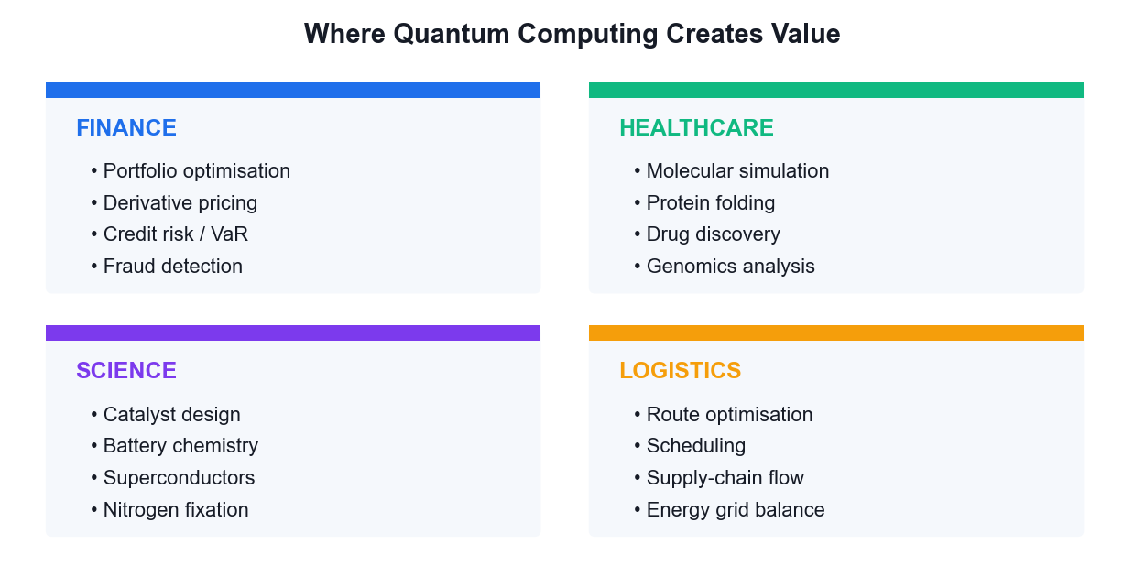
USE CASES BY SECTOR
Where Quantum Creates Value
The best candidates are problems with quantum structure — chemistry and optimisation — not big-data problems.
Securing the Future with Quantum Computing and Cryptography · TGS-2024043419
© 2026 Tertiary Infotech Academy Pte Ltd
218

Slide 220
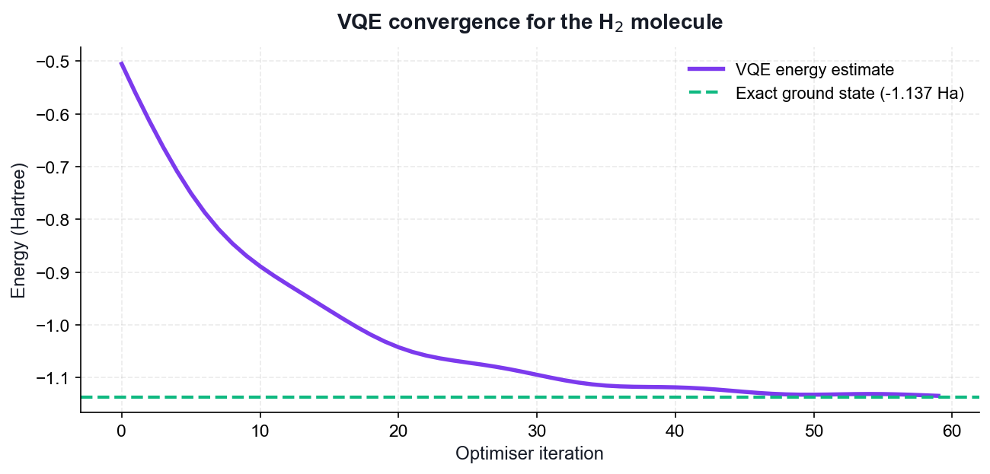
THE FLAGSHIP NEAR-TERM APPLICATION
VQE — Simulating Molecules
Hybrid loop
A quantum circuit prepares the trial state; a classical optimiser tunes it.
Noise tolerant
Shallow circuits make VQE practical on today's NISQ hardware.
The target
Ground-state energy — the quantity that drives chemistry.
The prize
Catalysts, batteries and drug candidates simulated exactly.
Securing the Future with Quantum Computing and Cryptography · TGS-2024043419
© 2026 Tertiary Infotech Academy Pte Ltd
219

Slide 221
A PRACTICAL CHECKLIST FOR LO4
Assessing a Quantum Use Case
Does the problem have quantum structure?
Chemistry and optimisation map naturally; generic data processing does not.
How big is the data?
Loading large classical datasets into a quantum computer is itself a bottleneck.
1
2
What qubit count is needed?
Estimate logical qubits, then multiply for error-correction overhead.
Is there a good classical method?
If a classical heuristic already solves it well, quantum adds nothing.
3
4
What is the time horizon?
NISQ demos today; fault-tolerant advantage is a 2030s proposition.
What is the cost of waiting?
For cryptography the answer is high — migrate now.
5
6
Securing the Future with Quantum Computing and Cryptography · TGS-2024043419
© 2026 Tertiary Infotech Academy Pte Ltd
220

Slide 222
WHERE THE TWO TECHNOLOGIES MEET
Four distinct intersections
1. QUANTUM FOR AI — quantum algorithms to speed up machine learning
2. AI FOR QUANTUM — machine learning to make quantum computers work
3. QUANTUM-INSPIRED — classical algorithms borrowed from quantum ideas
4. SHARED INFRASTRUCTURE — hybrid classical/quantum/GPU pipelines
Intersection 2 is where the REAL commercial value sits today —
which is the reverse of what most headlines suggest.
KEY POINT: Be precise about which intersection is being discussed; they have completely different maturity levels.
Securing the Future with Quantum Computing and Cryptography · TGS-2024043419
© 2026 Tertiary Infotech Academy Pte Ltd
221

Slide 223
WHERE THE TWO TECHNOLOGIES MEET
Quantum machine learning — the honest state
QUANTUM KERNELS map data into a Hilbert space and compute inner
products a classical kernel cannot easily reach
VARIATIONAL (VQC) parameterised circuits trained like a neural net
QUANTUM NEURAL NETS layered ansätze with gradient-based training
REALITY CHECK:
• data loading is the bottleneck — encoding N classical values can
cost O(N), destroying any speedup
• BARREN PLATEAUS: gradients vanish exponentially with qubit count
• no proven advantage on a real-world ML dataset yet
KEY POINT: Teach this honestly. Quantum ML is a genuine research field with real open problems, not a shipping product.
Securing the Future with Quantum Computing and Cryptography · TGS-2024043419
© 2026 Tertiary Infotech Academy Pte Ltd
222

Slide 224
WHERE THE TWO TECHNOLOGIES MEET
AI for quantum — the part that works today
Machine learning is already ESSENTIAL to running quantum hardware:
• QUBIT CALIBRATION — RL agents tune pulse parameters continuously
• ERROR DECODING — neural decoders beat classical matching on surface
codes, and run fast enough for real-time correction
• CIRCUIT COMPILATION — ML finds better gate decompositions and routing
• NOISE CHARACTERISATION — learn the device error model, then mitigate
• ANSATZ DESIGN — search the space of variational circuits
Google, IBM and Quantinuum all use ML decoders in production stacks.
KEY POINT: This is the intersection with proven, deployed value — and a strong career area for someone with both skill sets.
Securing the Future with Quantum Computing and Cryptography · TGS-2024043419
© 2026 Tertiary Infotech Academy Pte Ltd
223

Slide 225
WHERE THE TWO TECHNOLOGIES MEET
Quantum-inspired classical algorithms
Studying quantum algorithms has produced better CLASSICAL ones:
• TENSOR NETWORKS (MPS, PEPS) — from quantum many-body physics,
now used to compress neural networks
• Ewin Tang's 'dequantisation' — classical algorithms matching the
quantum recommendation-system speedup
• simulated annealing variants inspired by quantum annealing
A quantum algorithm that gets dequantised is still a scientific win —
you end up with a faster classical method.
KEY POINT: Useful framing for business stakeholders: quantum R&D pays dividends even when the quantum hardware is not ready.
Securing the Future with Quantum Computing and Cryptography · TGS-2024043419
© 2026 Tertiary Infotech Academy Pte Ltd
224

Slide 226
WHERE THE TWO TECHNOLOGIES MEET
Where they converge: chemistry
The most credible near-term combination:
1. QUANTUM computer simulates a molecule that is classically intractable
2. Results become high-quality TRAINING DATA
3. An AI MODEL (e.g. a graph neural net) learns from that data
4. The AI screens MILLIONS of candidate molecules cheaply
5. The quantum computer verifies only the top candidates
Quantum supplies scarce, high-accuracy ground truth; AI supplies scale.
KEY POINT: This division of labour plays to each technology's actual strength instead of pitting them against each other.
Securing the Future with Quantum Computing and Cryptography · TGS-2024043419
© 2026 Tertiary Infotech Academy Pte Ltd
225

Slide 227
WHERE THE TWO TECHNOLOGIES MEET
Security implications of the convergence
AI ACCELERATES CRYPTANALYSIS — ML-assisted side-channel attacks and
lattice-reduction heuristics are active research areas
PQC MUST PROTECT AI SYSTEMS — model weights, training data and
inference APIs all need quantum-safe transport and signing
AI DEFENDS — anomaly detection can flag harvest-now traffic capture
MODEL PROVENANCE — signing model artifacts with ML-DSA guards the
AI supply chain against tampering
KEY POINT: Model weights are long-lived, extremely high-value secrets — a textbook harvest-now-decrypt-later target.
Securing the Future with Quantum Computing and Cryptography · TGS-2024043419
© 2026 Tertiary Infotech Academy Pte Ltd
226

Slide 228
WHERE THE TWO TECHNOLOGIES MEET
Realistic outlook
TODAY (NISQ) AI runs quantum hardware. Quantum ML is research.
~2029 (early FT) first logical qubits; quantum chemistry feeds AI
training sets; PQC migration should be complete
2030s fault-tolerant chemistry and materials at scale;
quantum-generated data becomes routine in AI pipelines
CONSTANT the security work does NOT wait for any of this.
Harvest-now-decrypt-later is a TODAY problem.
KEY POINT: The security timeline is independent of the computing timeline — that is the single most important message to take back to work.
Securing the Future with Quantum Computing and Cryptography · TGS-2024043419
© 2026 Tertiary Infotech Academy Pte Ltd
227

Slide 229
WHAT YOU'LL DO
Hands-On Activities — Quantum Computing Applications and Use Cases
Activity 15
Activity 16
• Molecular Simulation with VQE (Healthcare & Science)
• Portfolio Optimisation with QAOA (Finance)
Securing the Future with Quantum Computing and Cryptography · TGS-2024043419
© 2026 Tertiary Infotech Academy Pte Ltd
228

Slide 230
TOPIC 07 · HANDS-ON ACTIVITY
ACTIVITY 15
Molecular Simulation with VQE (Healthcare & Science)
Run the Variational Quantum Eigensolver to compute the ground-state energy of the hydrogen molecule — the flagship near-term use case for drug discovery, catalysis and materials science.
MAPS TO LO4, LO7 — Evaluate quantum computing applicability in the business context
YOU'LL PRODUCE
A VQE run that converges to the H2 ground-state energy, with an energy-versus-iteration convergence plot.
Tools: Qiskit 2.x, SciPy optimiser, matplotlib, IBM Quantum
Full step-by-step guide: Learner Guide — Activity 15: Molecular Simulation with VQE (Healthcare & Science)
Securing the Future with Quantum Computing and Cryptography · TGS-2024043419
© 2026 Tertiary Infotech Academy Pte Ltd
229

Slide 231
ACTIVITY 15 · VERIFY & DEBRIEF
Molecular Simulation with VQE (Healthcare & Science)
TEST IT — HOW YOU KNOW IT WORKED
The VQE optimisation converges to an energy close to the exact H2 ground-state value of about -1.137 Hartree, and the convergence plot shows the energy decreasing monotonically toward that limit.
DISCUSS WITH YOUR TRAINER
What did the result show?
Why does it work?
Where would you use it?
Restate the outcome in your own words.
Name the quantum principle the activity relies on.
Give one realistic application in your own field.
Securing the Future with Quantum Computing and Cryptography · TGS-2024043419
© 2026 Tertiary Infotech Academy Pte Ltd
230

Slide 232
TOPIC 07 · HANDS-ON ACTIVITY
ACTIVITY 16
Portfolio Optimisation with QAOA (Finance)
Apply the Quantum Approximate Optimization Algorithm to a Max-Cut style combinatorial problem, the same structure that underlies portfolio selection, routing and scheduling in financial services.
MAPS TO LO4, LO6 — Evaluate applicability and select appropriate algorithms
YOU'LL PRODUCE
A QAOA run that finds the optimal cut on a small graph, with the solution quality compared against brute force.
Tools: Qiskit 2.x, NetworkX, SciPy, matplotlib
Full step-by-step guide: Learner Guide — Activity 16: Portfolio Optimisation with QAOA (Finance)
Securing the Future with Quantum Computing and Cryptography · TGS-2024043419
© 2026 Tertiary Infotech Academy Pte Ltd
231

Slide 233
ACTIVITY 16 · VERIFY & DEBRIEF
Portfolio Optimisation with QAOA (Finance)
TEST IT — HOW YOU KNOW IT WORKED
The most frequently sampled bit string from the optimised QAOA circuit corresponds to the true maximum cut found by brute force, and the approximation ratio improves as the number of layers p increases.
DISCUSS WITH YOUR TRAINER
What did the result show?
Why does it work?
Where would you use it?
Restate the outcome in your own words.
Name the quantum principle the activity relies on.
Give one realistic application in your own field.
Securing the Future with Quantum Computing and Cryptography · TGS-2024043419
© 2026 Tertiary Infotech Academy Pte Ltd
232

Slide 234
TOPIC RECAP
Recap — Quantum Computing Applications and Use Cases
• Finance
• Healthcare and life sciences
• Science and materials
• Optimisation and logistics
• Quantum machine learning
• Assessing business value
Securing the Future with Quantum Computing and Cryptography · TGS-2024043419
© 2026 Tertiary Infotech Academy Pte Ltd
233

Slide 235
08
TOPIC 08
Quantum Error Correction
Bit and Phase Flip Errors · QEC Algorithms · Fault Tolerance · The Future
Securing the Future with Quantum Computing and Cryptography · TGS-2024043419
© 2026 Tertiary Infotech Academy Pte Ltd
234

Slide 236
MAPS TO LO7
Key Concepts — Quantum Error Correction
Why QEC is needed
Qubits decohere and gates are imperfect; without correction, errors accumulate long before a useful algorithm completes.
Quantum-specific challenges
No-cloning forbids simple copying, errors are continuous rather than discrete, and measurement destroys the state.
1
2
Syndrome measurement
Ancilla qubits are measured to reveal WHICH error occurred without ever measuring — and collapsing — the logical state.
Bit-flip and phase-flip codes
Three-qubit repetition codes correct X errors; conjugating with Hadamards turns phase flips into bit flips.
3
4
Shor, Steane and surface codes
Shor's 9-qubit code corrects arbitrary single-qubit errors; Steane uses 7; surface codes are today's leading practical approach.
Fault tolerance
Below the error threshold, concatenating codes suppresses errors faster than they accumulate — the path to useful quantum computers.
5
6
Securing the Future with Quantum Computing and Cryptography · TGS-2024043419
© 2026 Tertiary Infotech Academy Pte Ltd
235

Slide 237
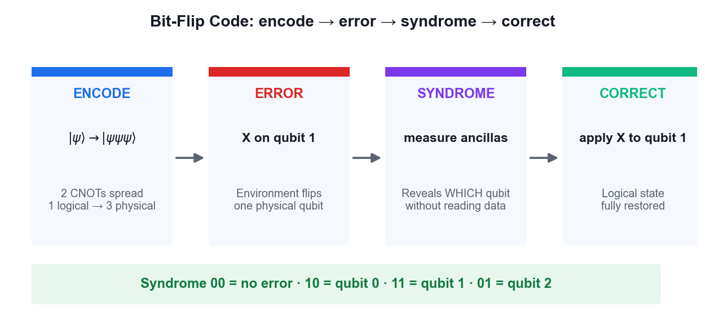
ENCODE · ERROR · SYNDROME · CORRECT
Bit-Flip Code — The QEC Cycle
The syndrome reveals WHICH qubit flipped without ever measuring — and destroying — the logical state.
Securing the Future with Quantum Computing and Cryptography · TGS-2024043419
© 2026 Tertiary Infotech Academy Pte Ltd
236

Slide 238
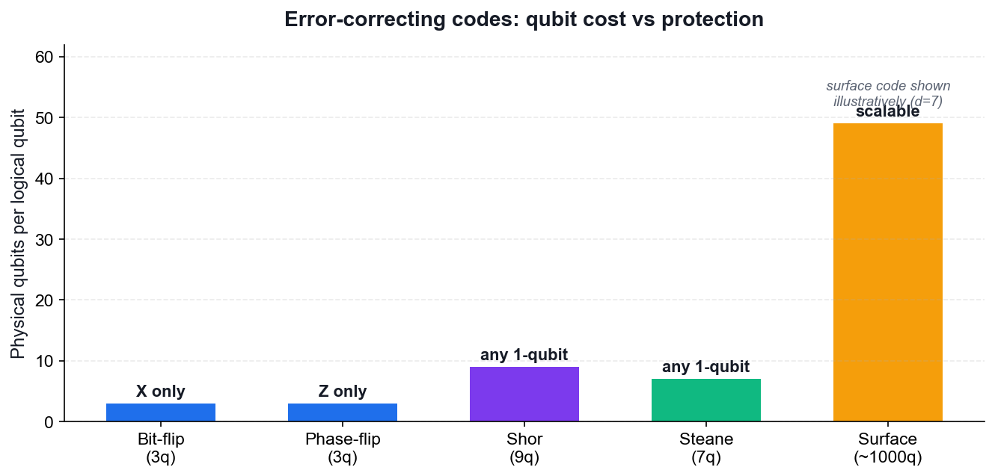
QUBIT COST VS PROTECTION
Error-Correcting Codes Compared
3-qubit codes
Correct either bit flips or phase flips, but not both.
Shor 9-qubit
The first code to correct an arbitrary single-qubit error.
Steane 7-qubit
A CSS code achieving the same protection more efficiently.
Surface codes
2D nearest-neighbour layout — today's leading practical approach.
Securing the Future with Quantum Computing and Cryptography · TGS-2024043419
© 2026 Tertiary Infotech Academy Pte Ltd
237

Slide 239
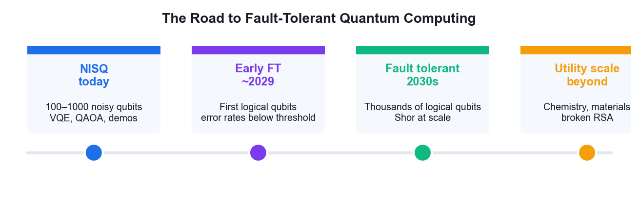
WHERE THE INDUSTRY IS HEADED
The Road to Fault Tolerance
Below the error threshold, adding more physical qubits suppresses errors faster than they accumulate.
Securing the Future with Quantum Computing and Cryptography · TGS-2024043419
© 2026 Tertiary Infotech Academy Pte Ltd
238

Slide 240
DERIVATION
Proof — Quantum Error Correction Works
CLAIM
Syndrome measurement identifies WHICH error occurred without learning — and therefore without collapsing — the encoded logical state.
GIVEN
Encode one logical qubit into three physical qubits (the bit-flip code).
Logical states: |0>_L = |000>, |1>_L = |111>.
An arbitrary logical state: |ψ>_L = a|000> + b|111>.
Assume at most ONE qubit suffers an X (bit-flip) error.
Securing the Future with Quantum Computing and Cryptography · TGS-2024043419
© 2026 Tertiary Infotech Academy Pte Ltd
239

Slide 241
QUANTUM ERROR CORRECTION WORKS · STEP 1 OF 8
Step 1 — Why naive copying is forbidden
The obvious classical fix is to make three copies:
|ψ>|ψ>|ψ> = (a|0>+b|1>)(a|0>+b|1>)(a|0>+b|1>)
But no-cloning FORBIDS this for unknown |ψ>.
What we build instead is the ENTANGLED state
a|000> + b|111> which is NOT |ψ>|ψ>|ψ>
WHY THIS STEP: Encoding spreads the information across three qubits without ever duplicating it.
Securing the Future with Quantum Computing and Cryptography · TGS-2024043419
© 2026 Tertiary Infotech Academy Pte Ltd
240

Slide 242
QUANTUM ERROR CORRECTION WORKS · STEP 2 OF 8
Step 2 — Encoding circuit
Two CNOTs, both controlled by the data qubit:
(a|0> + b|1>)|0>|0>
--CNOT(0->1)--> a|00>|0> + b|11>|0>
--CNOT(0->2)--> a|000> + b|111>
= |ψ>_L
WHY THIS STEP: Note a and b are never measured, never learned, never copied.
Securing the Future with Quantum Computing and Cryptography · TGS-2024043419
© 2026 Tertiary Infotech Academy Pte Ltd
241

Slide 243
QUANTUM ERROR CORRECTION WORKS · STEP 3 OF 8
Step 3 — An error strikes
Suppose X acts on qubit 1:
X₁ (a|000> + b|111>) = a|010> + b|101>
The state is corrupted — but observe that the amplitudes a and b are INTACT.
Only the BASIS LABELS have been permuted.
WHY THIS STEP: This is the crucial observation: the error moved the state to a different, distinguishable subspace without touching the encoded information.
Securing the Future with Quantum Computing and Cryptography · TGS-2024043419
© 2026 Tertiary Infotech Academy Pte Ltd
242

Slide 244
QUANTUM ERROR CORRECTION WORKS · STEP 4 OF 8
Step 4 — Syndrome operators
Measure the two PARITY observables (stabilisers):
S₁ = Z₀Z₁ (parity of qubits 0 and 1)
S₂ = Z₁Z₂ (parity of qubits 1 and 2)
Critically, both COMMUTE with the logical operators, and:
S₁|000> = +|000>, S₁|111> = +|111>
so S₁ has the SAME eigenvalue on both logical basis states.
WHY THIS STEP: Because the eigenvalue does not depend on whether the state is |000> or |111>, measuring it reveals NOTHING about a and b.
Securing the Future with Quantum Computing and Cryptography · TGS-2024043419
© 2026 Tertiary Infotech Academy Pte Ltd
243

Slide 245
QUANTUM ERROR CORRECTION WORKS · STEP 5 OF 8
Step 5 — The syndrome table
Apply the stabilisers to the corrupted state a|010> + b|101>:
error S₁ = Z₀Z₁ S₂ = Z₁Z₂ syndrome
none +1 +1 00
X on q0 -1 +1 10
X on q1 -1 -1 11
X on q2 +1 -1 01
Every single-qubit error gives a DISTINCT syndrome.
WHY THIS STEP: Four outcomes, four distinguishable cases — the code can locate any single bit flip.
Securing the Future with Quantum Computing and Cryptography · TGS-2024043419
© 2026 Tertiary Infotech Academy Pte Ltd
244

Slide 246
QUANTUM ERROR CORRECTION WORKS · STEP 6 OF 8
Step 6 — Why the logical state survives
Take the corrupted state a|010> + b|101>:
S₁ eigenvalue on |010> = -1 ; on |101> = -1 -> SAME
S₂ eigenvalue on |010> = -1 ; on |101> = -1 -> SAME
Both branches share the same syndrome, so measuring it does NOT
distinguish them — the superposition a·(…) + b·(…) is preserved intact.
WHY THIS STEP: THIS IS THE HEART OF QEC. The measurement projects onto an error subspace, not onto a logical basis state.
Securing the Future with Quantum Computing and Cryptography · TGS-2024043419
© 2026 Tertiary Infotech Academy Pte Ltd
245

Slide 247
QUANTUM ERROR CORRECTION WORKS · STEP 7 OF 8
Step 7 — Correction and generalisation
Syndrome 11 -> apply X to qubit 1:
X₁ (a|010> + b|101>) = a|000> + b|111> = |ψ>_L RESTORED
PHASE FLIPS: conjugate by Hadamards, since H X H = Z.
Encode as |+++> / |---> and the same circuit corrects Z errors.
ARBITRARY ERRORS: any single-qubit error is a linear combination
E = c₀I + c₁X + c₂Y + c₃Z
The syndrome measurement DISCRETISES it — projecting onto one of I, X, Y, Z.
WHY THIS STEP: Continuous errors become discrete ones. This 'digitisation of errors' is what makes fault tolerance possible at all.
Securing the Future with Quantum Computing and Cryptography · TGS-2024043419
© 2026 Tertiary Infotech Academy Pte Ltd
246

Slide 248
QUANTUM ERROR CORRECTION WORKS · STEP 8 OF 8
Step 8 — Shor, Steane and the threshold
Shor 9-qubit = phase-flip code (3) concatenated with bit-flip code (3)
-> corrects ANY single-qubit error.
Steane 7-qubit = CSS code from the [7,4] Hamming code — same protection,
fewer qubits, and transversal Clifford gates.
Surface code = 2D lattice, nearest-neighbour only, threshold ~1%.
THRESHOLD THEOREM: if the physical error rate p is below a threshold p_th,
concatenating the code to level L suppresses the logical error rate as
p_L ≈ p_th (p/p_th)^(2^L) -> doubly exponential suppression.
WHY THIS STEP: Below threshold, adding qubits makes the computer MORE reliable — that is the entire promise of fault-tolerant quantum computing.
Securing the Future with Quantum Computing and Cryptography · TGS-2024043419
© 2026 Tertiary Infotech Academy Pte Ltd
247

Slide 249
QED
Quantum Error Correction Works — Result
RESULT
The syndrome identifies the error without revealing a or b, so applying the indicated Pauli correction restores the logical state exactly. Below the error threshold, concatenation suppresses errors faster than they accumulate.
WHY IT MATTERS
Without QEC, decoherence destroys any long computation. Shor's algorithm on RSA-2048 needs billions of reliable operations — impossible with raw physical qubits at today's error rates, but achievable with error-corrected logical qubits.
Securing the Future with Quantum Computing and Cryptography · TGS-2024043419
© 2026 Tertiary Infotech Academy Pte Ltd
248

Slide 250
WHAT YOU'LL DO
Hands-On Activities — Quantum Error Correction
Activity 17
Activity 18
• Bit-Flip and Phase-Flip Error Correction Codes
• Shor 9-Qubit and Steane 7-Qubit Codes
Securing the Future with Quantum Computing and Cryptography · TGS-2024043419
© 2026 Tertiary Infotech Academy Pte Ltd
249

Slide 251
TOPIC 08 · HANDS-ON ACTIVITY
ACTIVITY 17
Bit-Flip and Phase-Flip Error Correction Codes
Build the three-qubit repetition codes that detect and correct X and Z errors: encode a logical qubit, inject an error, measure the syndrome without collapsing the state, and apply the correction.
MAPS TO LO7 — Synthesize quantum methodologies to address complex problems
YOU'LL PRODUCE
Working bit-flip and phase-flip code circuits that correctly identify and repair an injected single-qubit error.
Tools: Qiskit 2.x, IBM Quantum Runtime, OpenQASM
Full step-by-step guide: Learner Guide — Activity 17: Bit-Flip and Phase-Flip Error Correction Codes
Securing the Future with Quantum Computing and Cryptography · TGS-2024043419
© 2026 Tertiary Infotech Academy Pte Ltd
250

Slide 252
ACTIVITY 17 · VERIFY & DEBRIEF
Bit-Flip and Phase-Flip Error Correction Codes
TEST IT — HOW YOU KNOW IT WORKED
The syndrome measurement correctly identifies which qubit carried the injected error without collapsing the logical state, and applying the indicated correction restores the original logical qubit.
DISCUSS WITH YOUR TRAINER
What did the result show?
Why does it work?
Where would you use it?
Restate the outcome in your own words.
Name the quantum principle the activity relies on.
Give one realistic application in your own field.
Securing the Future with Quantum Computing and Cryptography · TGS-2024043419
© 2026 Tertiary Infotech Academy Pte Ltd
251

Slide 253
TOPIC 08 · HANDS-ON ACTIVITY
ACTIVITY 18
Shor 9-Qubit and Steane 7-Qubit Codes
Step up to codes that correct arbitrary single-qubit errors: Shor's 9-qubit concatenated code and Steane's more efficient 7-qubit CSS code, then compare their qubit overhead and discuss the road to fault tolerance.
MAPS TO LO7 — Synthesize quantum methodologies to address complex problems
YOU'LL PRODUCE
Working Shor 9-qubit and Steane 7-qubit code circuits, with a comparison of qubit cost against protection offered.
Tools: Qiskit 2.x, IBM Quantum Runtime, OpenQASM
Full step-by-step guide: Learner Guide — Activity 18: Shor 9-Qubit and Steane 7-Qubit Codes
Securing the Future with Quantum Computing and Cryptography · TGS-2024043419
© 2026 Tertiary Infotech Academy Pte Ltd
252

Slide 254
ACTIVITY 18 · VERIFY & DEBRIEF
Shor 9-Qubit and Steane 7-Qubit Codes
TEST IT — HOW YOU KNOW IT WORKED
Both the Shor 9-qubit and Steane 7-qubit circuits detect and correct an arbitrary injected single-qubit error (X, Y or Z), and you can state the qubit overhead each code requires.
DISCUSS WITH YOUR TRAINER
What did the result show?
Why does it work?
Where would you use it?
Restate the outcome in your own words.
Name the quantum principle the activity relies on.
Give one realistic application in your own field.
Securing the Future with Quantum Computing and Cryptography · TGS-2024043419
© 2026 Tertiary Infotech Academy Pte Ltd
253

Slide 255
TOPIC RECAP
Recap — Quantum Error Correction
• Why QEC is needed
• Quantum-specific challenges
• Syndrome measurement
• Bit-flip and phase-flip codes
• Shor, Steane and surface codes
• Fault tolerance
Securing the Future with Quantum Computing and Cryptography · TGS-2024043419
© 2026 Tertiary Infotech Academy Pte Ltd
254

Slide 256
WRAP-UP
Course Summary & Next Steps
Securing the Future with Quantum Computing and Cryptography · TGS-2024043419
© 2026 Tertiary Infotech Academy Pte Ltd
255

Slide 257
LEARNING OUTCOMES ACHIEVED
What You Achieved
1
Quantum foundations
Built the state vectors, unitary and Hermitian operators behind every algorithm.
2
Quantum systems
Visualised qubits on the Bloch sphere and ran circuits on real IBM hardware.
3
Gates and circuits
Applied the full gate set and constructed Bell and GHZ entangled states.
4
Quantum protocols
Implemented teleportation, superdense coding and BB84 with eavesdropper detection.
5
Quantum algorithms
Ran Deutsch, Deutsch-Jozsa, Bernstein-Vazirani, Grover and the QFT.
6
Cryptography and safety
Ran Shor's period finding and built a PQC migration plan.
7
Applications
Simulated H₂ with VQE and optimised with QAOA.
8
Error correction
Encoded, diagnosed and corrected errors with the bit-flip, Shor and Steane codes.
Securing the Future with Quantum Computing and Cryptography · TGS-2024043419
© 2026 Tertiary Infotech Academy Pte Ltd
256

Slide 258
NEXT STEPS
Continue Your Quantum Journey
IBM Quantum Learning
Free courses and challenges at learning.quantum.ibm.com.
Qiskit documentation
The reference for every gate, primitive and runtime feature.
1
2
PennyLane demos
Excellent tutorials on variational and quantum-machine-learning methods.
NIST PQC
Track FIPS 203/204/205 adoption and vendor migration guidance.
3
4
Practise the labs
Re-run every activity in this course from a blank notebook.
Stay current
Quantum hardware roadmaps shift yearly — follow the vendor announcements.
5
6
Securing the Future with Quantum Computing and Cryptography · TGS-2024043419
© 2026 Tertiary Infotech Academy Pte Ltd
257

Slide 259
FINAL ASSESSMENT
Assessment
Written Assessment (WA)
Practical Performance (PP)
• Short-Answer Questions (SAQ)
• 1 hour · open book
• Tests underpinning KNOWLEDGE
• Covers all eight topics
• Hands-on quantum tasks
• 1 hour · open book
• Tests PRACTICAL ability
• Built on the class activities
OPEN BOOK — course slides, Learner Guide and approved materials only
Eligibility: minimum 75% attendance + assessed Competent. An appeal process is available.
Securing the Future with Quantum Computing and Cryptography · TGS-2024043419
© 2026 Tertiary Infotech Academy Pte Ltd
258

Slide 260
ON ASSESSMENT DAY
Assessment Flow
Complete every step in order — the TRAQOM survey and digital attendance are mandatory for funding.
Securing the Future with Quantum Computing and Cryptography · TGS-2024043419
© 2026 Tertiary Infotech Academy Pte Ltd
259

Slide 261
TRAQOM · SSG DIGITAL ATTENDANCE
Digital Attendance (Mandatory)
1
2
3
4
▶
▶
▶
Trainer displays the digital attendance QR code from the SSG portal
Scan the QR code with your mobile phone camera
Submit your attendance — AM, PM and Assessment, every day
75% minimum attendance is required for assessment and funding
Securing the Future with Quantum Computing and Cryptography · TGS-2024043419
© 2026 Tertiary Infotech Academy Pte Ltd
260

Slide 262
END OF COURSE
Thank You!
You can now design quantum models, apply quantum gates, select quantum algorithms and plan a post-quantum migration — the skills that secure the future.
Securing the Future with Quantum Computing and Cryptography · TGS-2024043419
© 2026 Tertiary Infotech Academy Pte Ltd
261

